Slide 1
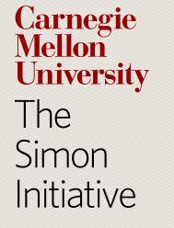

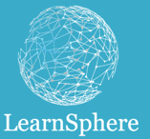
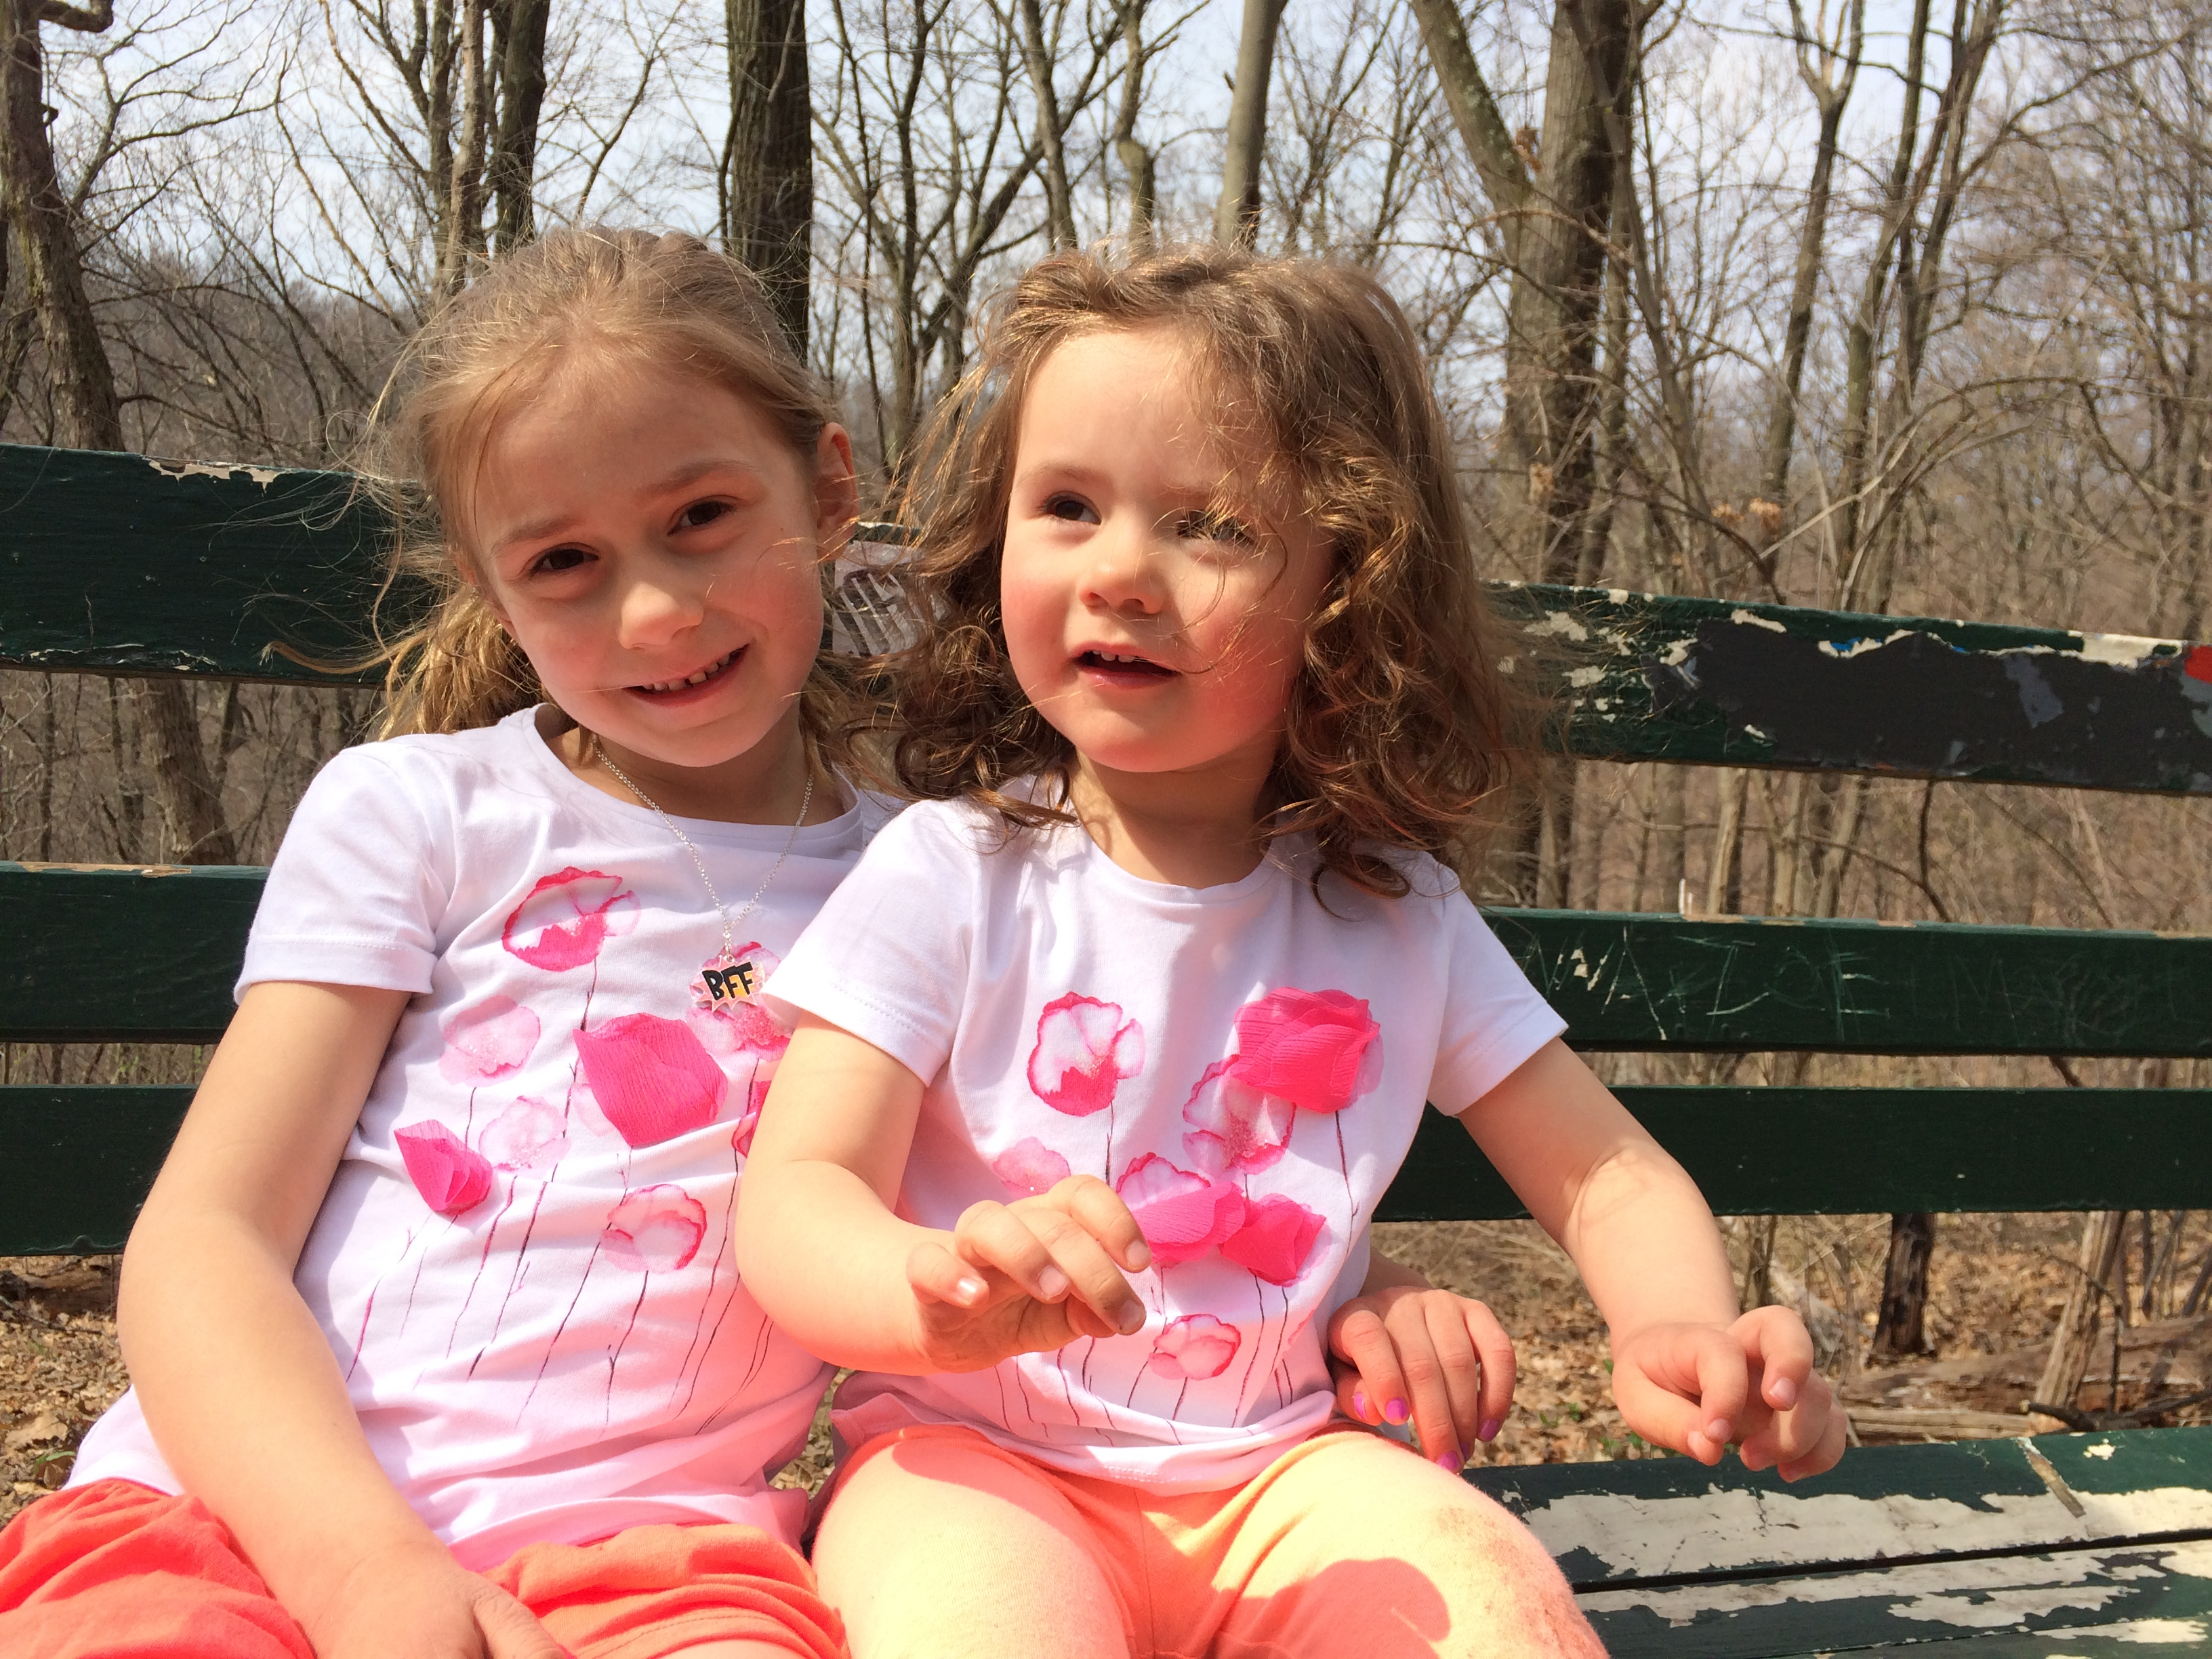
Data and Models of Learning to Improve Education
Ken Koedinger
Professor of Human-Computer Interaction & Psychology
Carnegie Mellon University
Director of Co-leader of
EDM Test of Time Award, July 15, 2018
Notes:
As another test of time – my first daughter, Alexandra, was born in 2007 while we were writing the 2008 paper and another in 2011.

Slide 2
Award paper
Koedinger, Cunningham, Skogsholm, & Leber (2008). An open repository and analysis tools for fine-grained, longitudinal learner data. Proceedings of EDM2008.
Closely related follow up
Koedinger, Baker, Cunningham, Skogsholm, Leber, & Stamper (2010). A data repository for the EDM community: The PSLC DataShop. Handbook of educational data mining.
Notes:
I bring up the related follow-up because it has received more attention (perhaps because of the attention of the Handbook) and because it indicates the important contributions that Ryan Baker and John Stamper have made.
Many others have also made important contributions including, but not limited to, Phil Pavlik, Ran Liu, Cindy, …

Slide 3
A Travel through Time!
Before 2008: Getting to DataShop
2008 paper: DataShop emerges
After 2008: Closing-the-loop, LearnSphere
After 2018: Computational models to scale

Slide 4
Take-away Messages
Machine learning (ML) is great: Data is even better
ML is neither necessary or sufficient
Pursue EDM as a means vs. as an end?
  What end? Learning science? Ed improvement?
Data & analytics are accumulating:
Let’s do more:
  Sharing → LearnSphere, require sharing with pubs…
  Close-the-loop experiments
  Theory: Explanation, computational theories
Automate with insight!
Notes:
Machine Learning is neither necessary or sufficient for scientific insight or practical impact
Beware of a second (more public) AI Winter …
Sharing → LearnSphere, require sharing with pubs, citations for shared data, shared methods
Theory: Interpretation, explanation, computational theories of learning, instruction, emotion
Automate using and producing insight. Automating without insight (e.g., “deep learning” alone) is going to cut it.

Slide 5
A Travel through Time!
Before 2008: Getting to DataShop
2008 paper: DataShop emerges
After 2008: Closing-the-loop, LearnSphere
After 2018: Computational models to scale

Slide 6
Leading up to DataShop
Early “log data” analysis
Repeated experiences in data informing or even contradicting intuitions
Learning curve analysis
  Evidence for ACT-R theory
  Used to improve Intelligent Tutors
Notes:
Test of time suggests some reflection … worth looking back at what led us to DataShop.

Slide 7
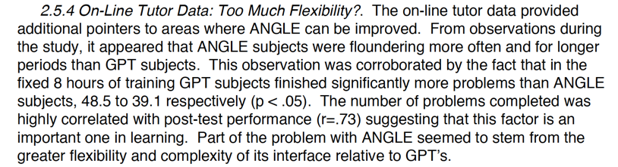
1993 Log Data Analysis – Comparing 2 ITSs for geometry proof
Koedinger, K.R., & Anderson, J.R. (1993). Reifying implicit planning in geometry: Guidelines for model-based intelligent tutoring system design. In Lajoie, S., & Derry, S. (Eds.) Computers as Cognitive Tools.

Slide 8
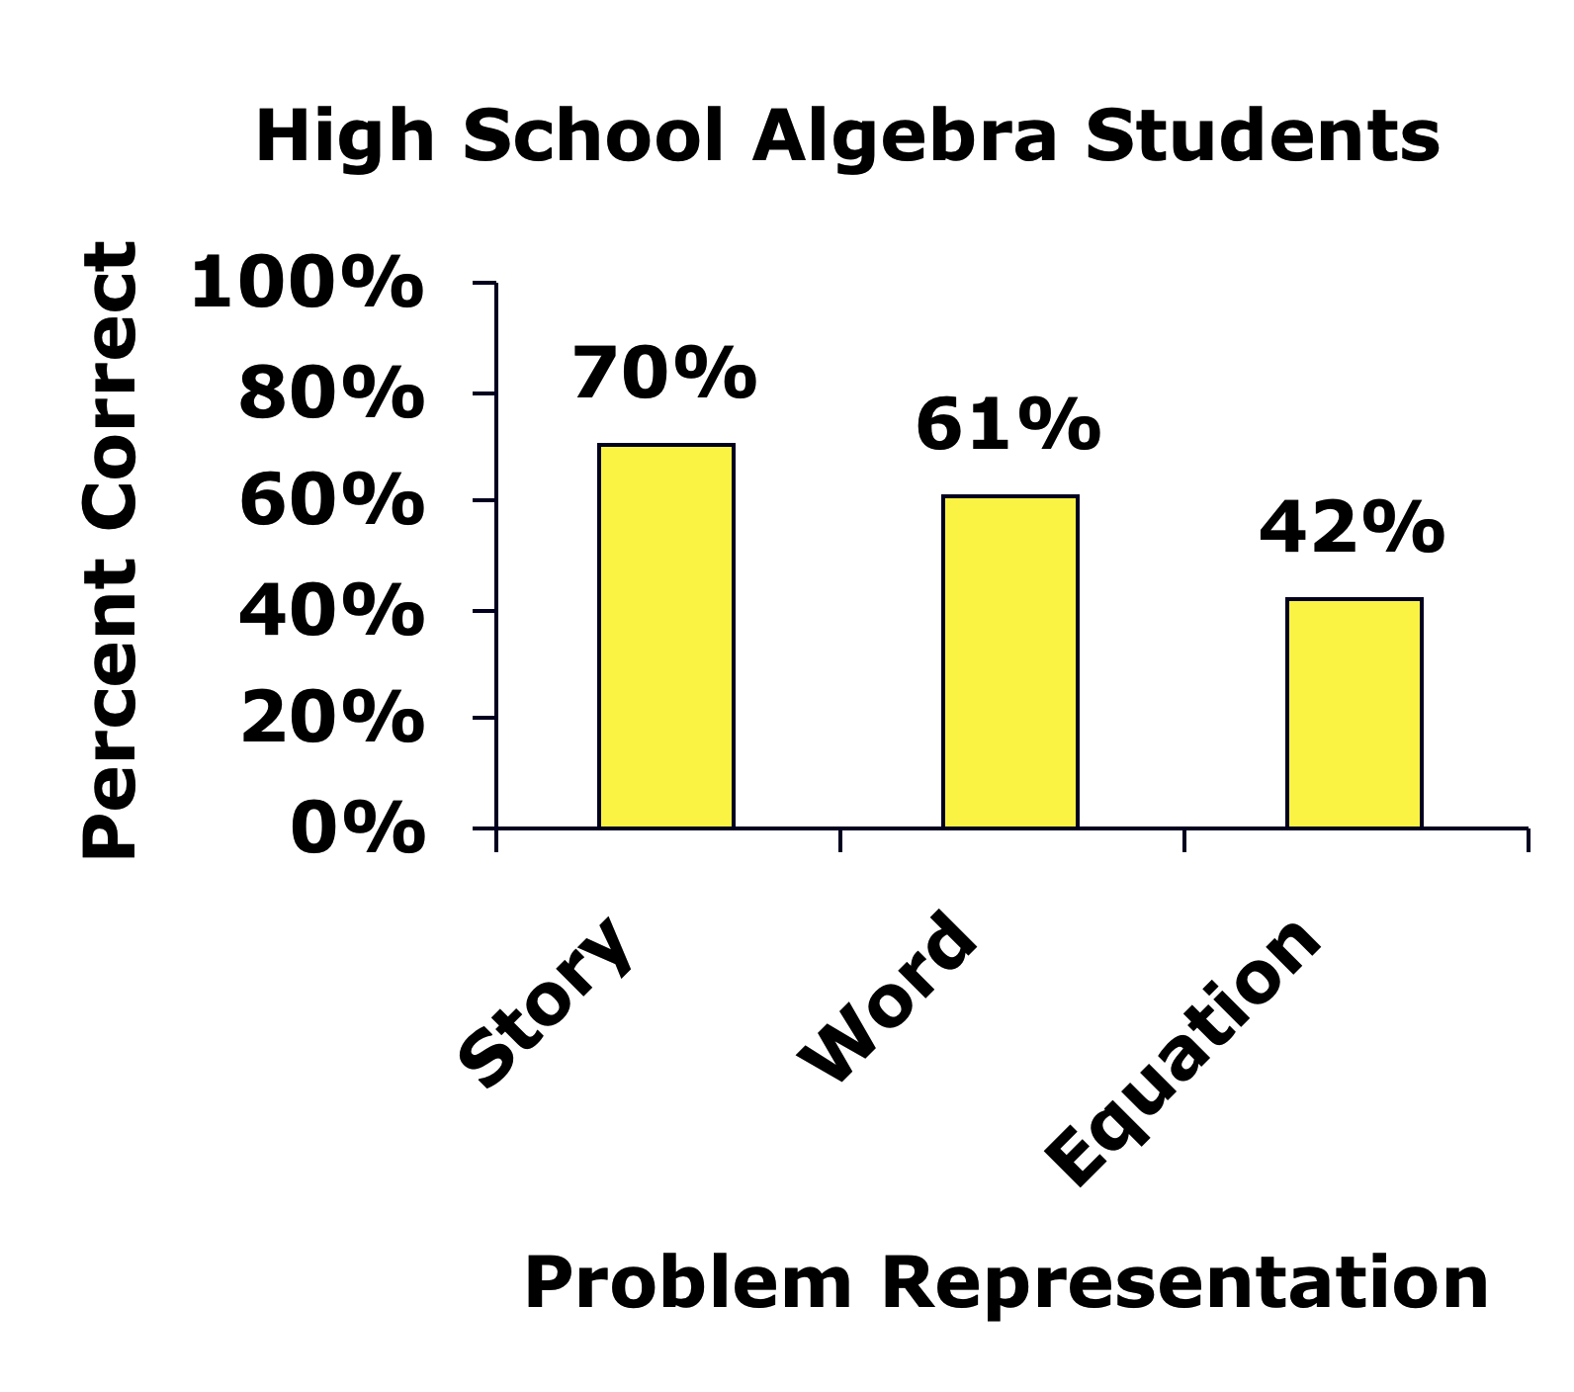
Data => Insight =>
Adaptation that works for all students
Which is harder for algebra students?
Story Problem
As a waiter, Ted gets $6 per hour. One night he made $66 in tips and earned a total of $81.90. How many hours did Ted work?
Word Problem
Starting with some number, if I multiply it by 6 and then add 66, I get 81.90. What number did I start with?
Equation
x * 6 + 66 = 81.90
Math educators say:
story or word is hardest
Students: equations are hardest
Expert blind spot!
Algebra teachers, especially, incorrectly think equations are easy
Koedinger & Nathan (2004). The real story behind story problems: Effects of representations on quantitative reasoning. Learning Science.
Notes:
The goal of DFA was to explore students ability to work with different representational formats.
What underlying, implicit knowledge is needed to be successful.
High school algebra teachers are least likely (<10%) to correctly indicate equation is hardest

Slide 9
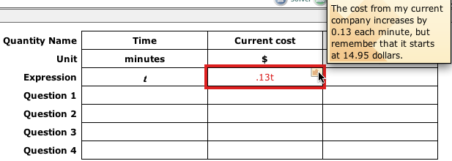
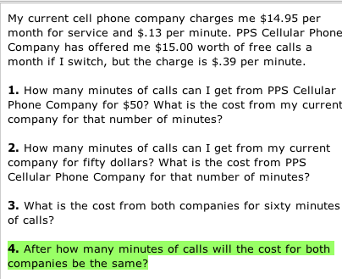
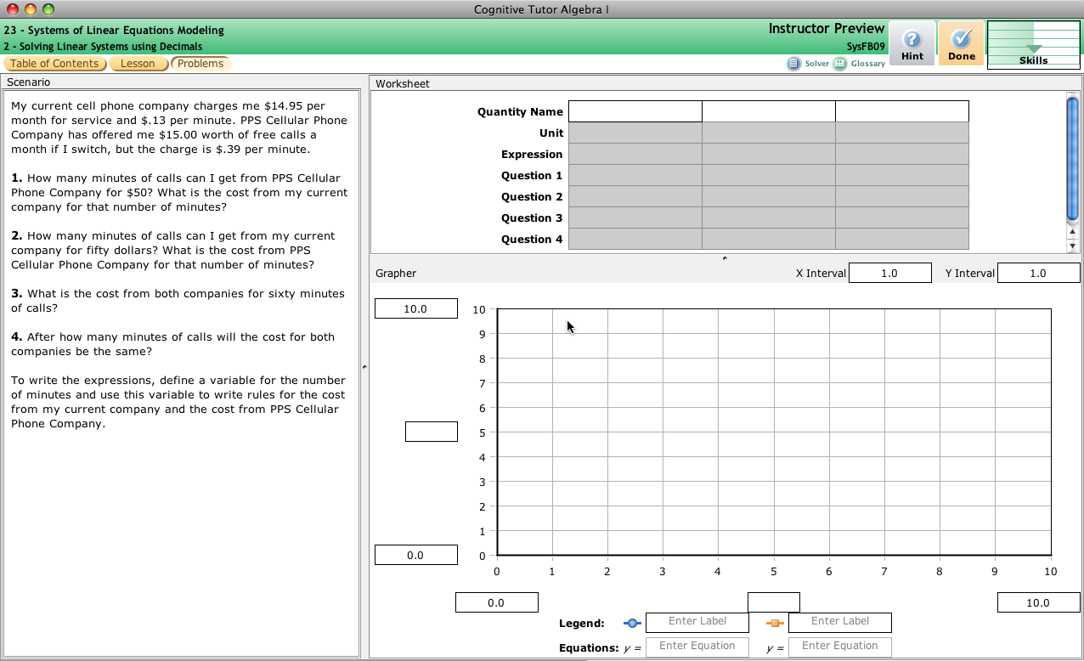
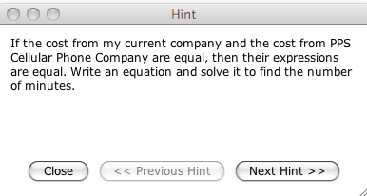
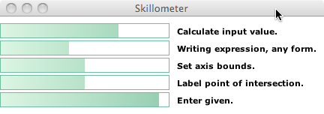
Cognitive Tutors: Adaptive Support for Learning by Doing
Authentic problems
Feedback within complex solutions
Progress…
Personalized instruction
Challenging questions
… individualization

Slide 10

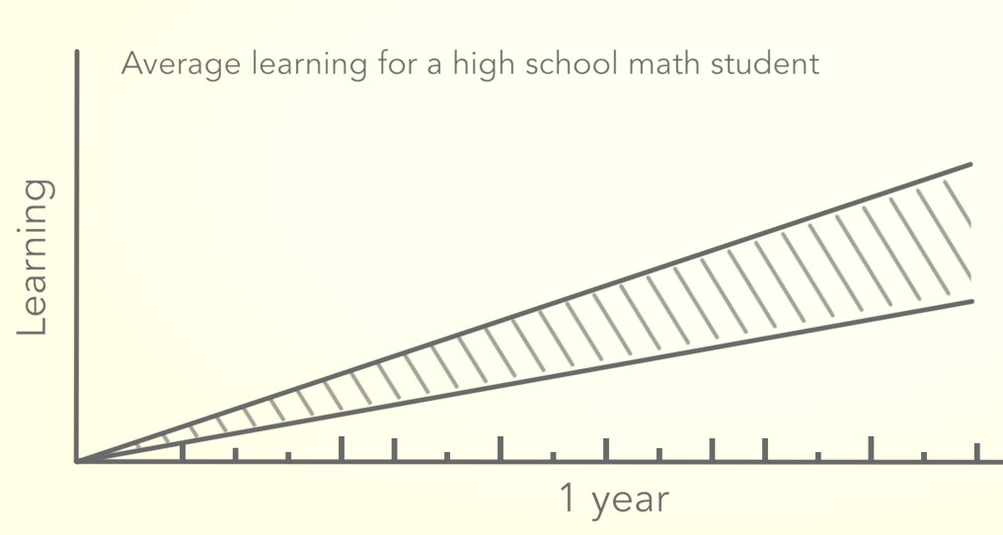
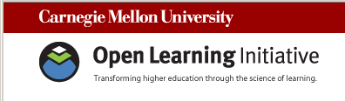
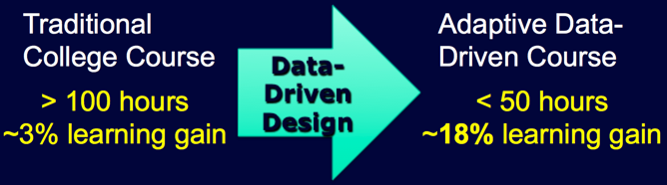
Randomized Field Trial Data => 2x improvement in learning
K12 Math Cognitive Tutors
Widely used
  ~500K students per year
  ~80 minutes per week
2x better learning
Cognitive Tutor Algebra
Traditional Algebra Course
Pane et al. (2013). Effectiveness of Cognitive Tutor Algebra I at Scale. Santa Monica, CA: RAND Corp.
College Online Courses
Widely used
  ~50K-1M students per year
  ~30 courses at 1K colleges
2x faster learning
Lovett et al. (2008). Measuring the effectiveness of the OLI learning course in accelerating student learning.
Interactive Media in Education.
Notes:
Practice to do in <40 seconds

Slide 11
Cognitive Tutors: Using Cognitive Modeling to Individualize Instruction
Cognitive Model: A system that can solve problems in the various ways students can
3(2x - 5) = 9
If goal is solve a(bx+c) = d
Then rewrite as abx + ac = d
If goal is solve a(bx+c) = d
Then rewrite as abx + c = d
If goal is solve a(bx+c) = d
Then rewrite as bx+c = d/a
6x - 15 = 9
2x - 5 = 3
6x - 5 = 9
Model Tracing: Follows student through their individual approach to a problem -> context-sensitive instruction

Slide 12
Cognitive Tutors: Using Cognitive Modeling to Individualize Instruction
Cognitive Model: A system that can solve problems in the various ways students can
3(2x - 5) = 9
If goal is solve a(bx+c) = d
Then rewrite as abx + ac = d
If goal is solve a(bx+c) = d
Then rewrite as abx + c = d
Hint message: “Distribute a
across the parentheses.”
Bug message: “You need to
multiply c by a also.”
Known? = 85% chance
Known? = 45%
6x - 15 = 9
2x - 5 = 3
6x - 5 = 9
Model Tracing: Follows student through their individual approach to a problem -> context-sensitive instruction
Knowledge Tracing: Assesses student's knowledge growth -> individualized activity selection and pacing

Slide 13
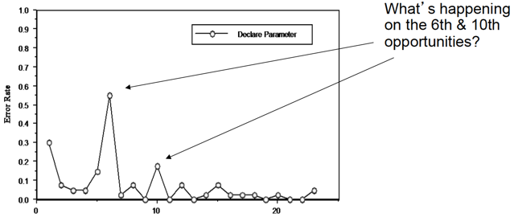
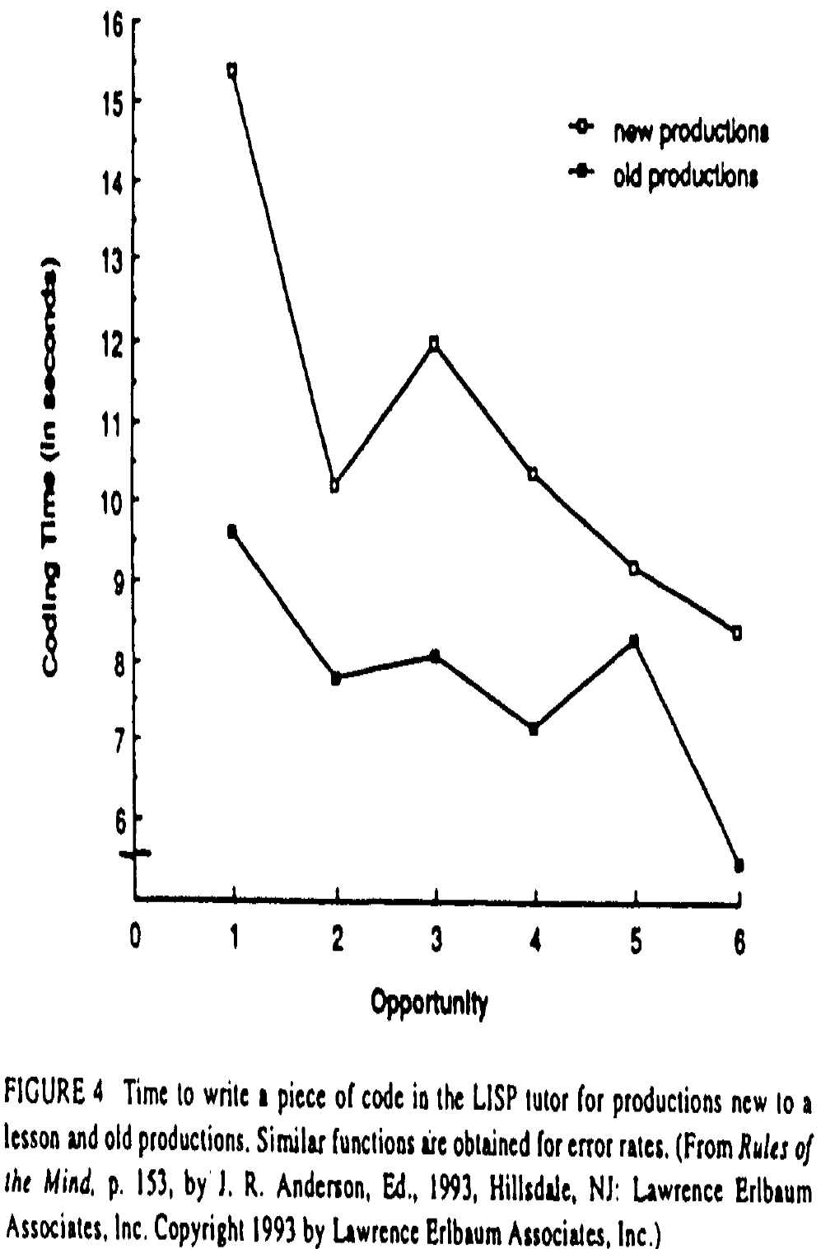
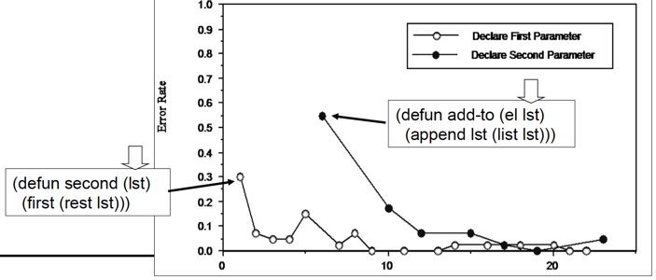
Early learning curves
Evidence for ACT-R:
Production rules better model learning than topics/theorems/words
A by-hand method to discover refinements in productions
Anderson, Corbett, Koedinger, & Pelletier (1995).
Cognitive Tutors: Lessons Learned. Learning Science.

Slide 14
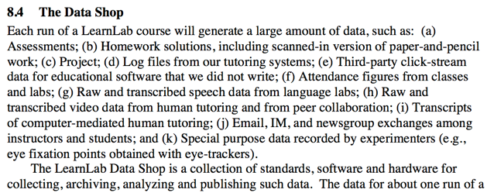
Original Plan for “The Data Shop”
Excerpt from
NSF proposal submitted Sept 17, 2003

Slide 15
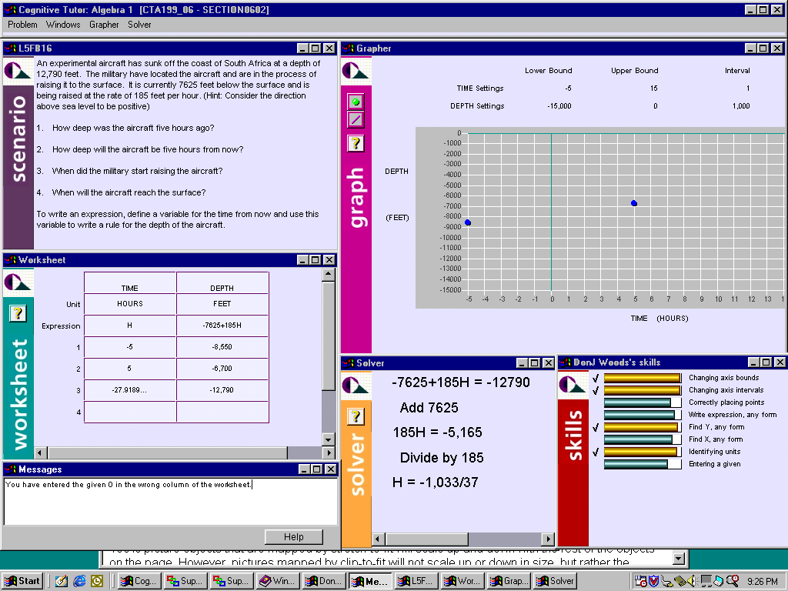
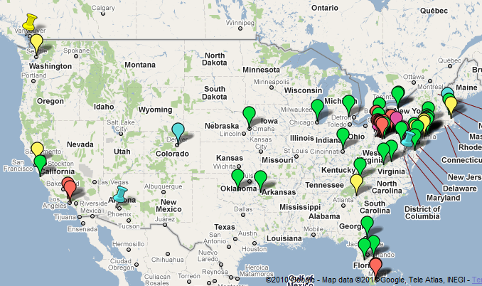

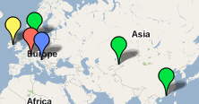
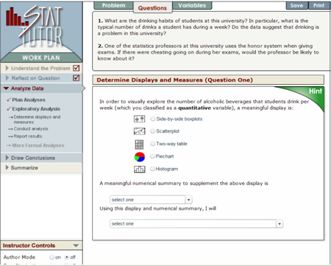

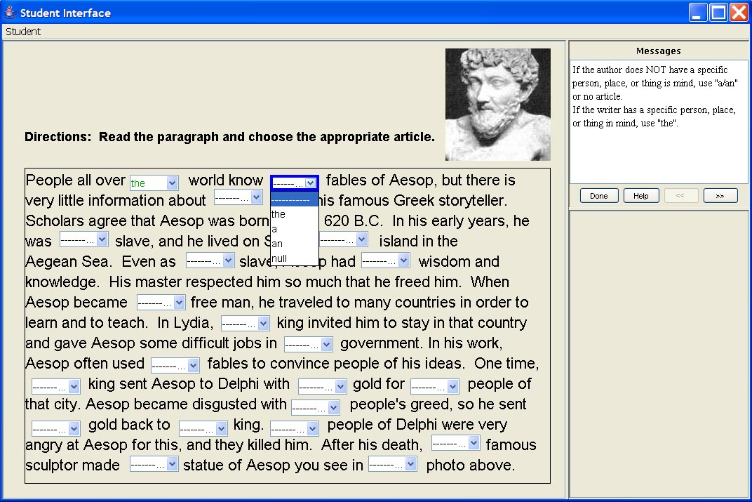
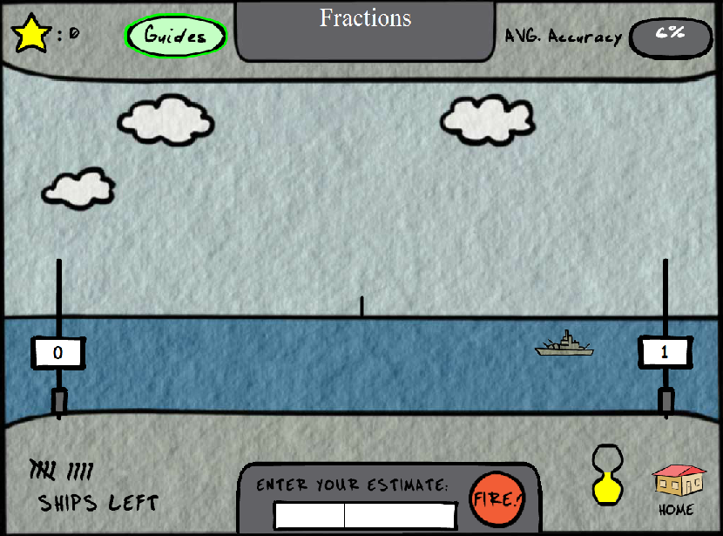
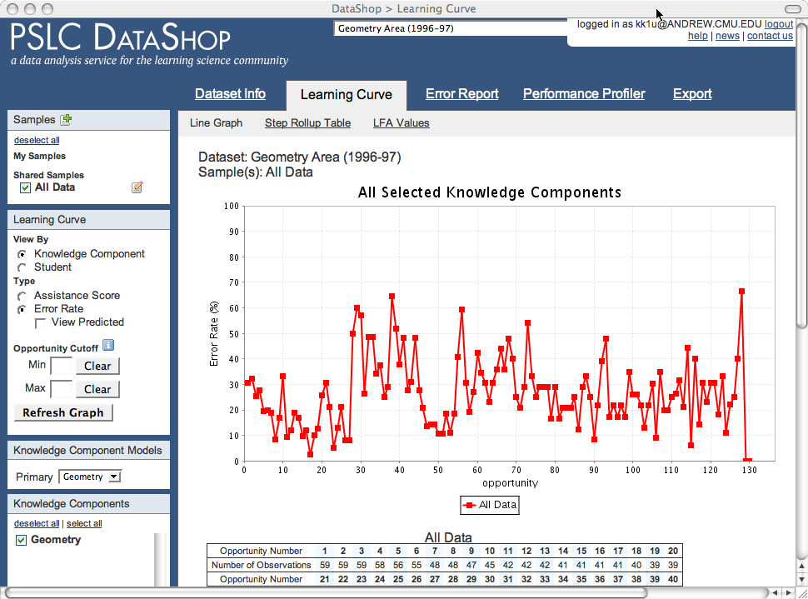
DataShop was born in LearnLab
Ed tech + wide use = “Basic research at scale”
Algebra Cognitive Tutor
+
=
Statistics Online
Researchers
Schools
NSF: $47M, 2004-15
English Grammar Tutor
> 360 in vivo experiments
> 1650 ed tech data sets in DataShop
Learn
Lab
Educational Games
Notes:
The PSLC builds on a rich history of cognitive science and education research in Pittsburgh, one manifestation of which has been the Cognitive Tutor technology that implements cognitive principles of learning in intelligent tutoring systems. The wide dissemination of our Algebra Cognitive Tutor inspired the idea that we could use such fielded technologies as a platform for doing basic research on learning with real students in real courses.
Two of our key goals are …
15

Slide 16
A Travel through Time!
Before 2008: Getting to DataShop
2008 paper: DataShop emerges
After 2008: Closing-the-loop, LearnSphere
After 2018: Computational models to scale

Slide 17
Award paper
Koedinger, Cunningham, Skogsholm, & Leber (2008). An open repository and analysis tools for fine-grained, longitudinal learner data. Proceedings of EDM2008.
Closely related follow up
Koedinger, Baker, Cunningham, Skogsholm, Leber, & Stamper (2010). A data repository for the EDM community: The PSLC DataShop. Handbook of educational data mining.
Notes:
I bring up the related follow-up because it has received more attention (perhaps because of the attention of the Handbook) and because it indicates the important contributions that Ryan Baker and John Stamper have made.
Many others have also made important contributions including, but not limited to, Phil Pavlik, Ran Liu, Cindy, …

Slide 18
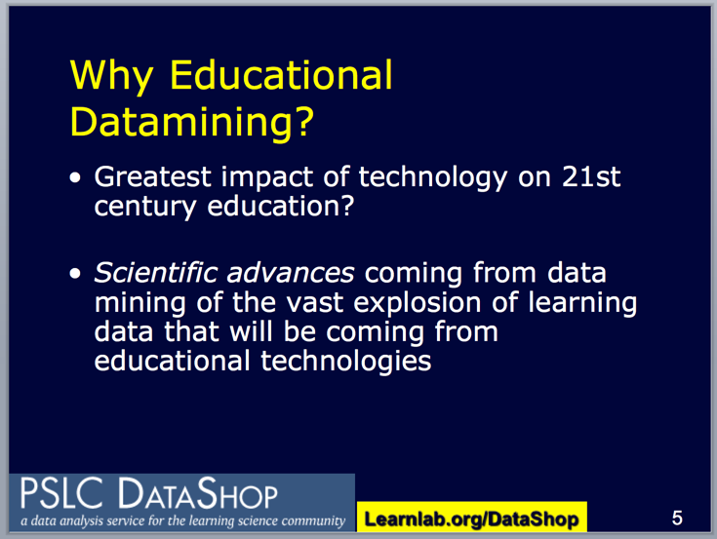
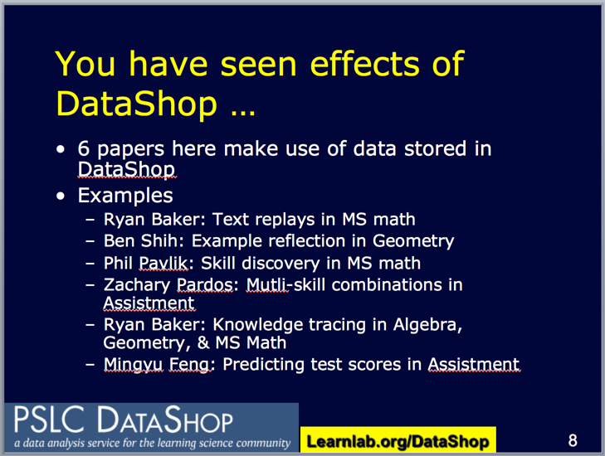
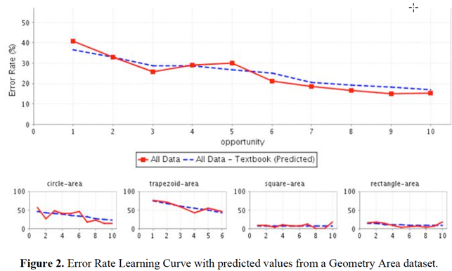
2008 paper

Slide 19
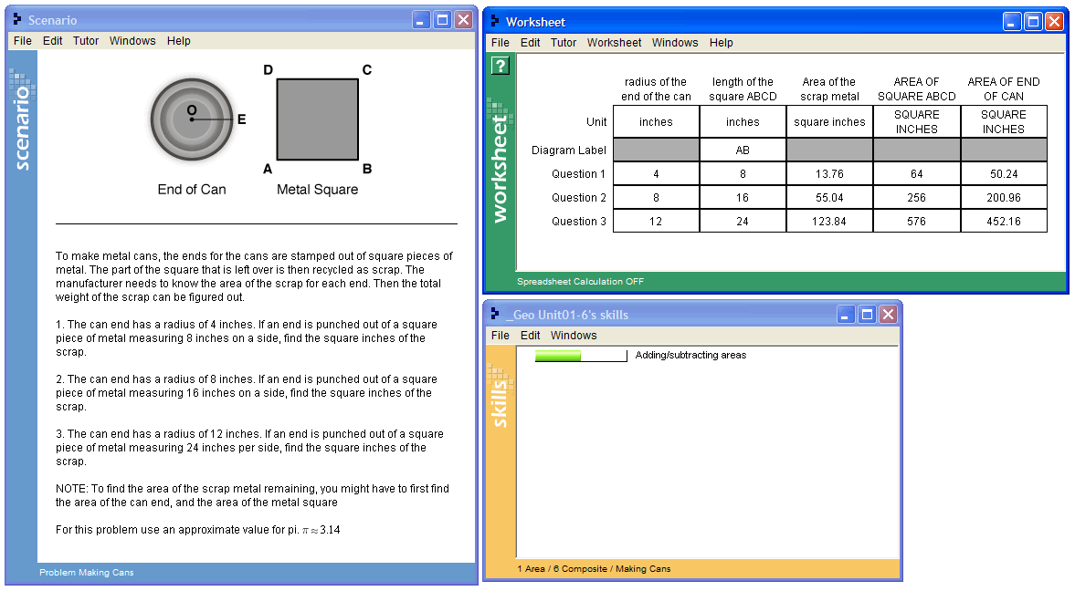
Example activity generating “click stream” data
Geometry Cognitive Tutor: “Making Cans” problem
  Find the area of scrap metal left over after removing a circular area (the end of a can) from a metal square.
  Student enters values in worksheet
Tutor provides feedback & instruction
  Records student’s actions & tutor responses
Logs stored in files on school server or database at Carnegie Learning
  Later imported into DataShop
Notes:
In the “Making Cans” example, a student completes a problem where she is asked to find the area of a piece of scrap metal left over after removing a circular area (the end of a can) from a metal square. The student enters everything in the worksheet except for the row labels, and column and ‘Unit’ labels for the first three columns. In addition to providing students with feedback and instruction, the tutor records the student’s actions and tutor responses, and stores them in a log file, which is imported and analyzed by DataShop

Slide 20
DataShop XML format: Tool & Tutor Messages
<tool_message context_message_id="C2badca9c5c:-7fe5">
<semantic_event transaction_id="T2a9c5c:-7fe7" name="ATTEMPT" />
<event_descriptor>
<selection>(POG-AREA QUESTION2)</selection>
<action>INPUT-CELL-VALUE</action>
<input>200.96</input>
</event_descriptor>
</tool_message>
<tutor_message context_message_id="C2badca9c5c:-7fe5">
<semantic_event transaction_id="T2a9c5c:-7fe7" name="RESULT" />
<event_descriptor> … [as above] … </event_descriptor>
<action_evaluation>CORRECT</action_evaluation>
</tutor_message>

Slide 21
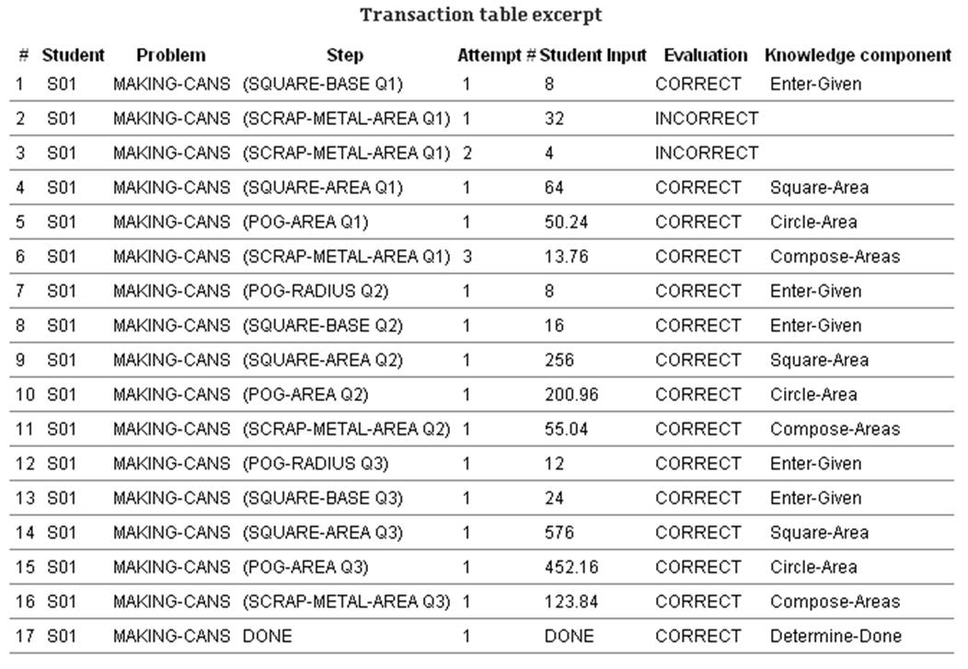
Example Stored Transactions
Student interactions (or transactions) are stored in a relational database, can be exported as table
  Example: Student S01 on Making-Cans problem

Slide 22
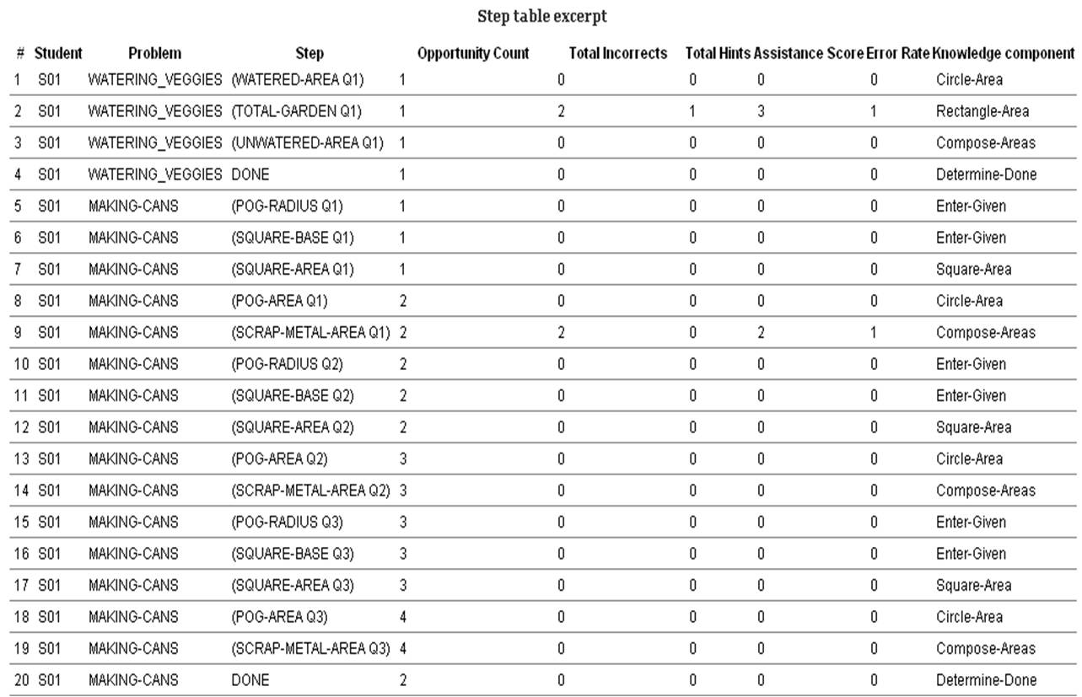
Example: data aggregated by student-step

Slide 23
A Travel through Time!
Before 2008: Getting to DataShop
2008 paper: DataShop emerges
After 2008: Closing-the-loop, LearnSphere
After 2018: Computational models to scale

Slide 24
Learning Curves

Slide 25
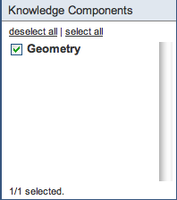
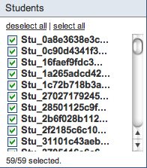
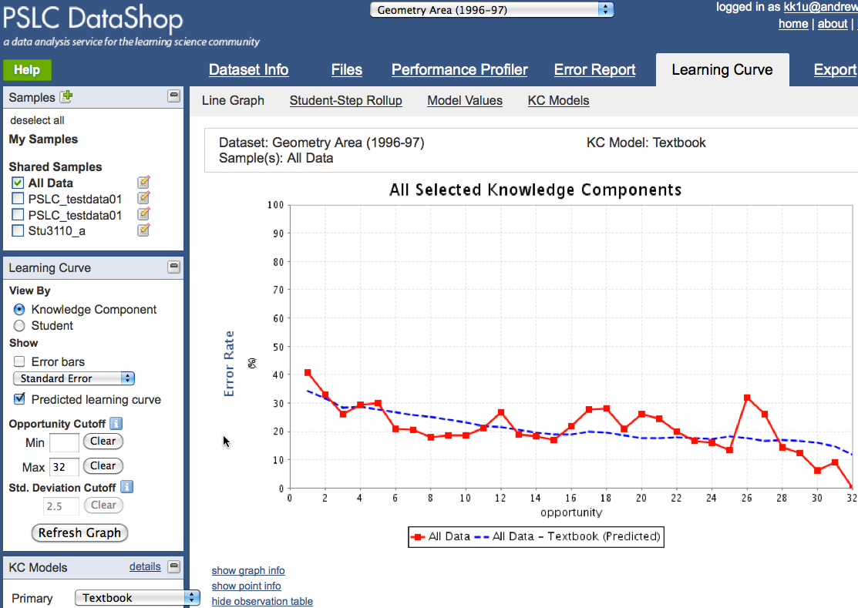
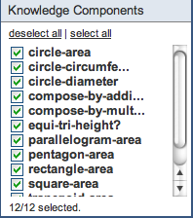
Cognitive Task Analysis using DataShop’s learning curve tools
Without decomposition, using just a single “Geometry” KC,
no smooth learning curve.
But with decomposition, 12 KCs for area concepts,
a smoother learning curve.
Upshot: Can automate analysis & produce better cognitive models

Slide 26
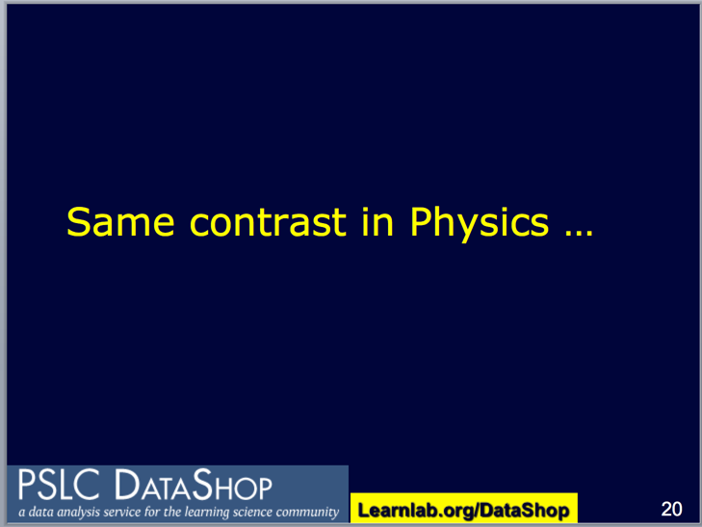
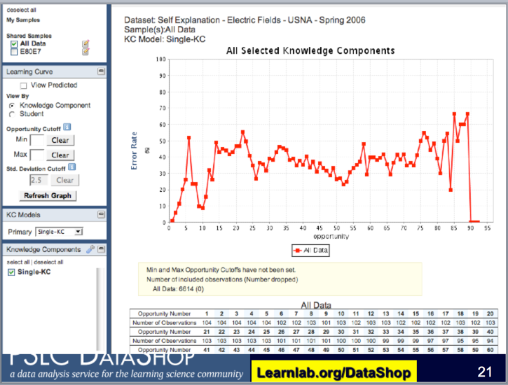
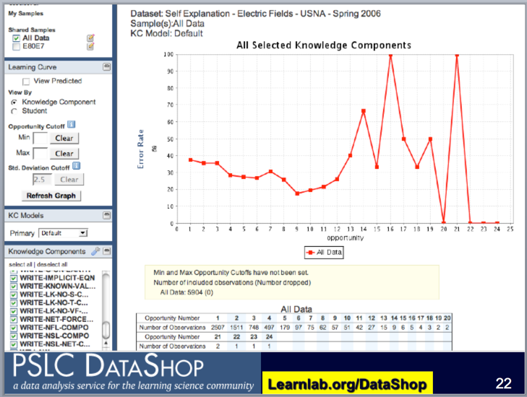
Works in many other domains!

Slide 27
Efficient cognitive task analysis to scale instructional impact
How should design the structure of deliberate practice to optimize learning?
Example: Should deliberate practice combine or separate instruction/experience on applying formulas “forward” vs. “backward”?
Use past learning data to generate sound hypothesis
  Compare alternative cognitive (KC) models
Redesign & run experiment to confirm
Shape | Formula | Forward | Backward
Rectangle | A = L*W | Find A given L, W | Find L given A, W
Trapezoid | A = ½(B+b)h | Find A given rest | Find b given rest
Circle | A = πr² | Find A given rest | Find r given rest

Slide 28
Log Data Input to LFA
Items = steps in tutors with step-based feedback
Q-matrix in single column: works for single KC items
Opportunities Student has had to learn KC
Student | Step (Item) | Skill (KC) | Opportunity | Success
A | p1s1 | Circle-area | 0 | 0
A | p2s1 | Circle-area | 1 | 1
A | p2s2 | Rectangle-area | 0 | 1
A | p2s3 | Compose-by-addition | 0 | 0
A | p3s1 | Circle-area | 2 | 0

Slide 29
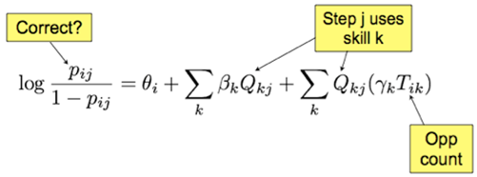
Statistical version of cognitive model: Generalization of item response theory
GIVEN:
pij = probability student i gets step j correct
Qkj = each knowledge component k needed for this step j
Tik = opportunities student i has had to practice k
ESTIMATED:
θi = proficiency of student i
βk = difficulty of KC k
γk = gain for each practice opportunity on KC k
Cen, Koedinger, & Junker (2006)
Draney, Pirolli, & Wilson (1995)
Spada & McGaw (1985)

Slide 30
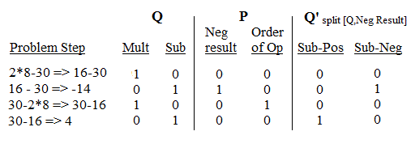
How to generate cognitive model candidates?
Requires psychology & domain expertise!
Key idea: modify Q matrix by factor in P matrix to get new Q’ matrix
Q matrix factor Sub split by P matrix factor Neg-result
Produces new Q matrix
Two new KCs (Sub-Pos & Sub-Neg) replace old KC (Sub)
  Redo opportunity counts

Slide 31
Statistical version of cognitive model: Generalization of item response theory
GIVEN:
pij = probability student i gets step j correct
Qkj = each knowledge component k needed for this step j
Tik = opportunities student i has had to practice k
ESTIMATED:
θi = proficiency of student i
βk = difficulty of KC k
γk = gain for each practice opportunity on KC k
Cen, Koedinger, & Junker (2006)
Draney, Pirolli, & Wilson (1995)
Spada & McGaw (1985)

Slide 32
Learning Factors Analysis: Cognitive Model Discovery via Search
Search algorithm guided by a heuristic: BIC
Start from an existing cog model (Q matrix)
Cen, H., Koedinger, K., Junker, B. (2006). Learning Factors Analysis: A general method for cognitive model evaluation and improvement. 8th International Conference on Intelligent Tutoring Systems.
Notes:
Automates the process of hypothesizing alternative cognitive models & testing them against data

Slide 33
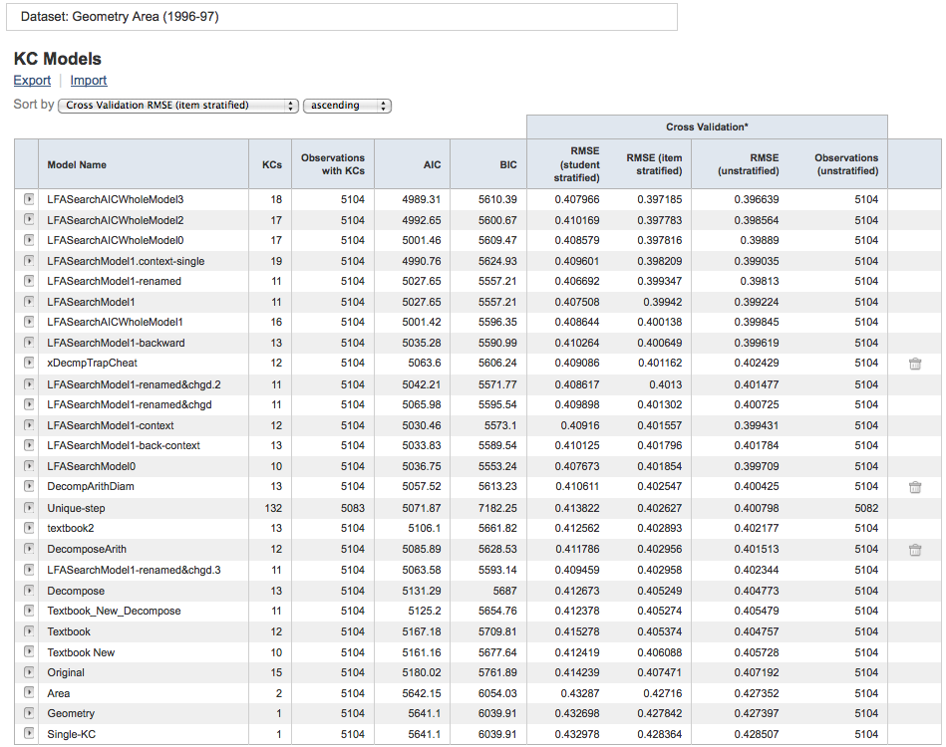
DataShop facilitates “social computing” combining people & machine learning:
Feature input (P) emerges naturally
Union of all hypothesized KCs in human generated models
Some models are human generated
Notes:
(i.e., sum of number of columns across existing models minus any duplicate columns)

Slide 34
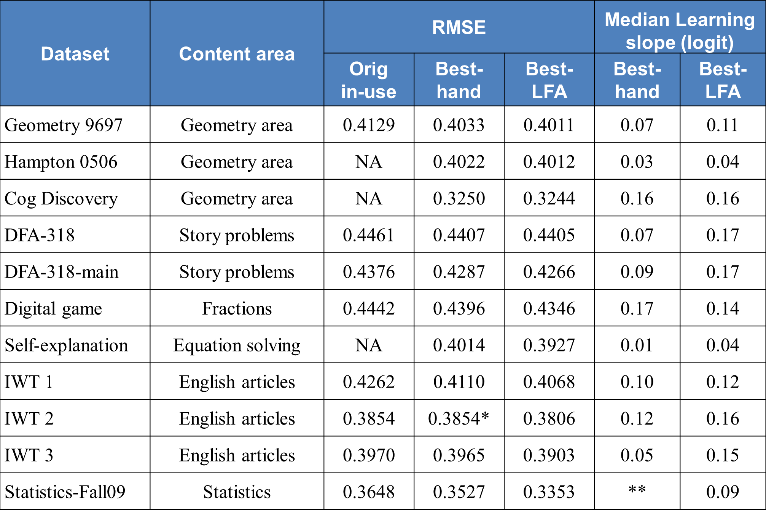
LFA Discovers better Cognitive Models
Koedinger, McLaughlin, & Stamper (2012). Automated student model improvement. In Proceedings of Educational Data Mining. [Best paper]
Variety of domains
& technologies
11 of 11 improved
models
9 of 11 equal
or greater learning
Notes:
NA: Original models (or statistics on them) were not available in some cases.
* IWT 2 dataset only has 1 model, therefore the original-in-use and best-hand models have the same RMSE.
**The best-hand model for Statistics-Fall09 dataset has only 1 KC.

Slide 35
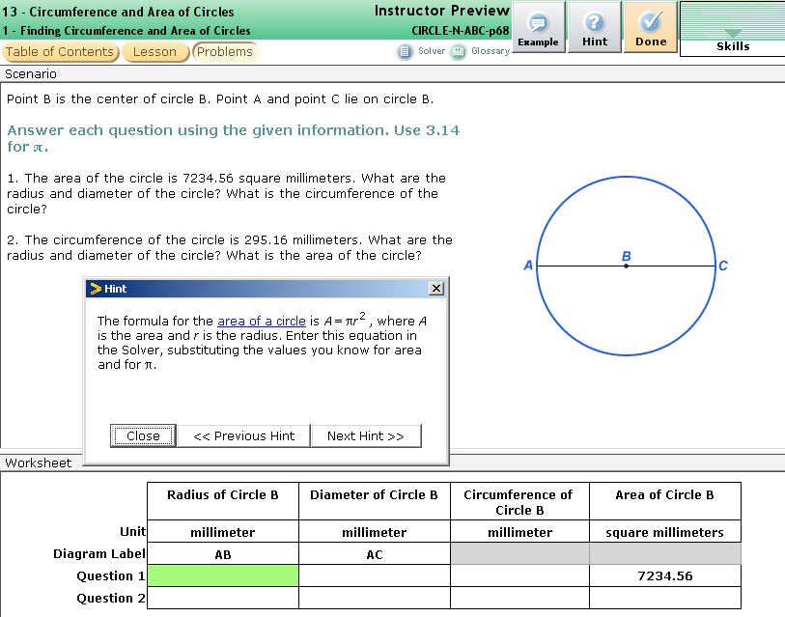
Example LFA discovery
backward circle-area problem
Big performance difference between
forward and backward problems (80% vs. 54%)
backward circumference problem
No performance difference between
forward and backward problems (77% vs. 79%)
Notes:
[Example]
[Backward area performance]
[Backward circumference performance]
[Interpretation]
If this is the true difficulty factor…

Slide 36
Cognitive process interpretation?
Shape | Formula | Harder to apply backward?
Rectangle | A = L*W | No
Triangle | A = ½ bh | No
Trapezoid | A = ½ (B+b)h | No
Circle | A = πr² | Yes

Slide 37
Cognitive process interpretation?
Shape | Formula | Harder to apply backward?
Rectangle | A = L*W | No
Triangle | A = ½ bh | No
Trapezoid | A = ½ (B+b)h | No
Circle | A = πr² | Yes
Circumference | C = πd | No
Square | A = s² | ?

Slide 38
Test interpretation on new dataset
Not blackbox machine learning!
Dataset from same tutoring system, much more recent deployment (2012 vs. 1996)
  Different school district, teachers, etc.
Many more circle area backward items
Square area forward and backward items
(Liu, Koedinger, & McLaughlin, 2014)
Notes:
To assess the external validity of the interpretation beyond the dataset from which the discoveries were made, we tested it on a novel dataset. The goal was not to simply apply the improved model directly to new data.
Rather, we wanted to test whether the interpretation itself held up within the context of novel data relevant to the interpretation but whose structure differed from those of the original dataset on which the LFA discovery was made.

Slide 39
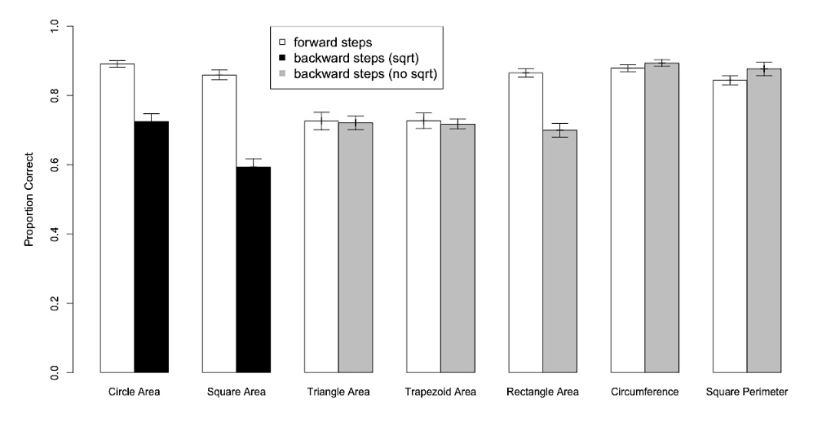
Generalization to a novel dataset
(Liu, Koedinger, & McLaughlin, 2014)
Notes:
First, we examined the overall performance data in this novel dataset. With the exception of rectangle area items, the differences in forward and backward item performances were specific to cases where the backward items required the application of a square root (circle-area and square-area).
we have some hypotheses about the discrepancy in the rectangle area behavior that I’m happy to discuss at the end – but it’s fairly peripheral to the main talk so for now I’m going to keep going.

Slide 40
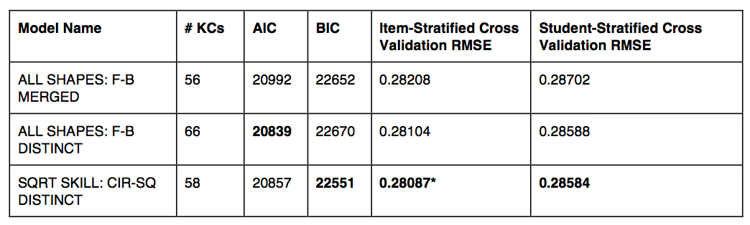
Generalization to a novel dataset
equivalent of original human-generated model
square-root interpretation driven model
(Liu, Koedinger, & McLaughlin, 2014)
Notes:
To further examine the robustness of our square root hypothesis, we selected three alternative skill models and evaluated their fit to data. [explain models]
The best-performing model, by each of the measures, is bolded.
The superior performance of SQRT SKILL CIR-SQ DISTINCT over ALL SHAPES F-B MERGED (on all measures) supports and extends the original LFA finding.
Notably, SQRT SKILL CIR-SQ DISTINCT even performs better, by cross validation and BIC measures, than the ALL SHAPES F-B DISTINCT. This validates the specificity of the square root operation hypothesis.

Slide 41
System redesign:
Changes to knowledge tracing
CONTROL
Knowledge-trace each shape as a single skill (backward & forward steps merged)
REDESIGN
Knowledge-trace circle and square backward/forward steps separately
Liu & Koedinger (2017). Closing the loop: Automated data-driven cognitive model discoveries lead to improved instruction and learning gains.
Journal of Educational Data Mining
Notes:
So, in light of the promising generalization results, we set out to redesign the tutor based on the interpretation of our modeling discovery.
[Discuss knowledge tracing]
One of the anticipated effects of the redesigned tutoring system was increased practice on backwards circle- and square-area items. Without any other adjustments, this would lead to the redesigned condition receiving overall more practice than the control condition. To control for this, we …
Liu, R., & Koedinger, K. (2017). Closing the loop: Automated data-driven cognitive model discoveries lead to improved instruction and learning gains. Journal of Educational Data Mining, 9(1).

Slide 42
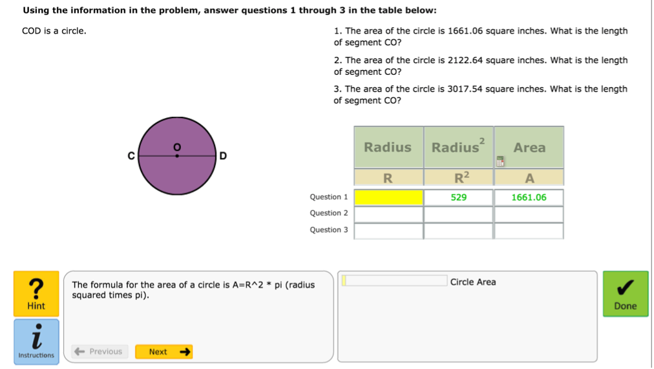
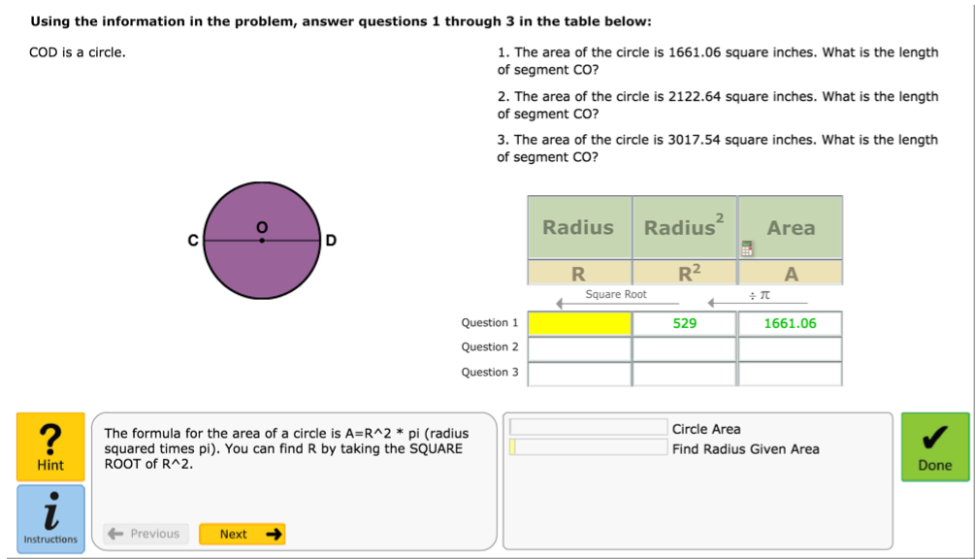
System redesign
Changes to interface
Changes to hints
Notes:
We also made changes to the interface.

Slide 43
Classroom in vivo experiment
115 students enrolled in geometry at a nearby High School
Random assignment at student level
  CONTROL - 57 students
  REDESIGN – 58 students
Five consecutive days
  PRETEST (12 questions)
  Tutor use
  POSTTEST (12 questions)
Liu & Koedinger (2017). Closing the loop: Automated data-driven cognitive model discoveries lead to improved instruction and learning gains.
Journal of Educational Data Mining
Notes:
They completed problems for each knowledge-traced skill until the skill was estimated to be mastered based on Bayesian Knowledge Tracing

Slide 44
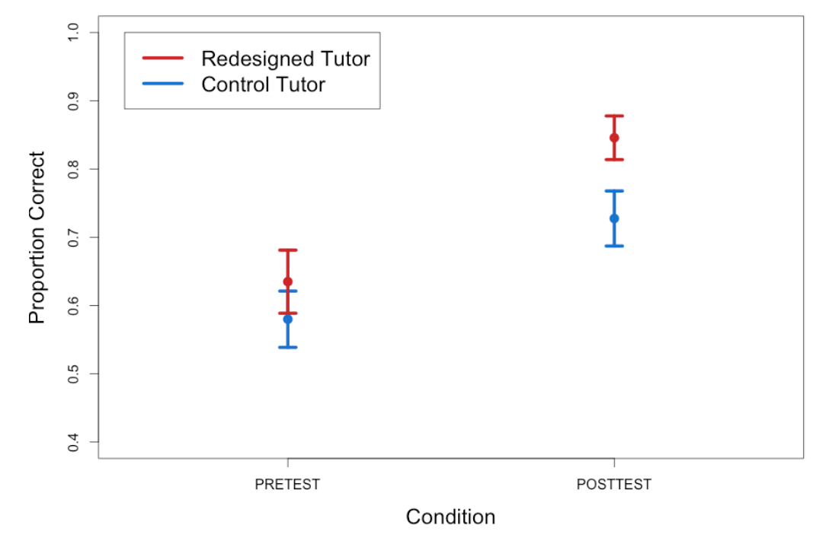
Results: Redesign produces significantly better learning
Condition (β=0.09, p=0.027) significantly predicts posttest results, controlling for the effects of pretest (β=0.59, p<0.001).
Liu & Koedinger (2017). Closing the loop: Automated data-driven cognitive model discoveries lead to improved instruction and learning gains. Journal of Educational Data Mining
Notes:
We ran a linear regression with pretest total scores and condition as predictors of posttest total scores. Controlling for pretest scores, condition significantly predicts posttest scores (β = 0.09, p = 0.027). The redesigned condition had significantly higher posttest scores (mean = 0.85) than the control condition (mean = 0.73), even when controlling for their pretest scores (redesigned condition mean = 0.63; control condition mean = 0.58).

Slide 45
A Travel through Time!
Before 2008: Getting to DataShop
2008 paper: DataShop emerges
After 2008: Closing-the-loop, LearnSphere
After 2018: Computational models to scale

Slide 46
Why create computational models of human learning?
Address “replication crisis” with theoretical learning science
  Explanations & predictions of what works under what circumstances
  Crash test teaching methods
Authoring intelligent tutors
  “Programming by tutoring”
Teachable agents
  Students learn by teaching machine

Slide 47
Why model human learning in machines?
Address “replication crisis” with theoretical learning science
Authoring intelligent tutors
Teachable agents
Li, Matsuda, Cohen, & Koedinger (2015). Integrating representation learning and skill learning in a human-like intelligent agent. Artificial Intelligence.
Li, Cohen, & Koedinger (2012). Problem order implications for learning transfer. Intelligent Tutoring Systems

Slide 48
Is it obvious what the cognitive components are?
Which problem is hardest?
Step | Human Student Error Rate
2x=12 | 0.27
6=3x | 0.29
-x=5 | 0.5
-24=-4x | 0.30

Slide 49
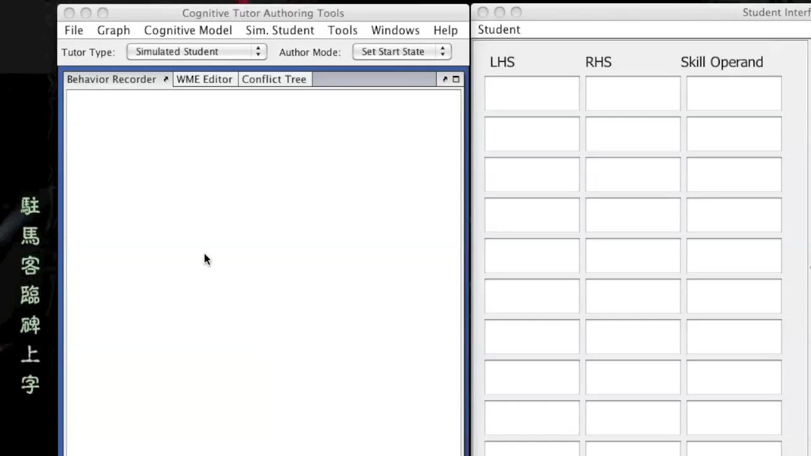
SimStudent is cognitive architecture that acquires expertise from exposure to perceptual stimuli (not shown in video)
and tutoring with example actions & feedback on its actions

Slide 50
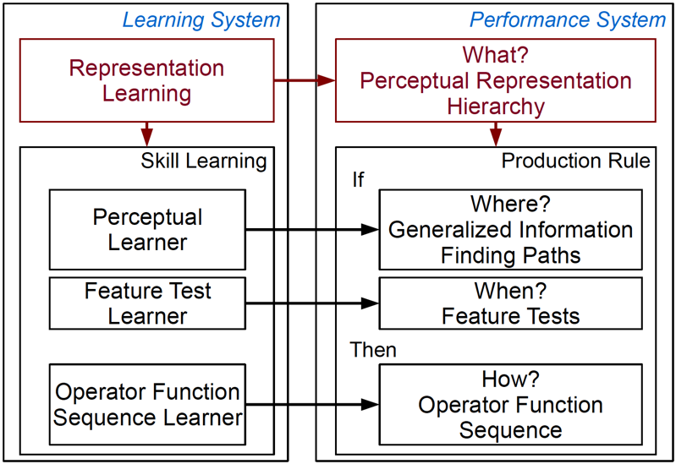
SimStudent: A computational theory of skill induction
Learning by induction from examples & doing
  Tacit learning of representations & skills
  No verbal instruction involved
Exposure to input
Structures input (WM)
Selects needed info
Feedback on errors
Decides when to act
Examples of input-response
Constructs behavioral output from info
Notes:
Add ref’s: Zhu & Simon; ACT-R/SOAR; Lenat re rep as inductive bias;
Perceptual chunks
Key challenges
Learning cues for decisions: if-part of production
Learning deep representational structure from perceptual input: perceptual chunking

Slide 51
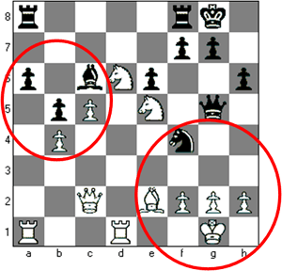
Representation learning through perceptual chunking
ELHRLO DWOL
HELLO WORLD
Use Probabilistic Context Free Grammar (pCFG) Induction
  Underlying structure in the problem → Grammar
Combined with if-part learning mechanisms, learns better than deep belief networks
Li, Matsuda, Cohen, & Koedinger (2015). Integrating representation learning and skill learning in a human-like intelligent agent. Artificial Intelligence.

Slide 52


Cognitive Models learned by SimStudent are more accurate than human-generated models

Slide 53
Beyond prediction: Insight from models yields better applications!
Which problem is hardest?
Step | Human Student Error Rate
2x=12 | 0.27
6=3x | 0.29
-x=5 | 0.5
-24=-4x | 0.30
SimStudent transfers learning between these
Different representation(parse)
=> Different production must be learned
Expert blind spot caused by lack of conscious awareness of representation learning. SimStudent facilitates automated discovering of such hidden skills

Slide 54
Why model human learning in machines?
Address “replication crisis” with theoretical learning science
Authoring intelligent tutors
Teachable agents
Matsuda et al. (2011). Learning by Teaching SimStudent – An Initial Classroom Baseline Study Comparing with Cognitive Tutor. Proceedings of Artificial Intelligence in Education.

Slide 55


APLUS: Artificial Peer Learning environment Using SimStudent
x+12/7
Matsuda et al. (2011). Learning by Teaching SimStudent. Proceedings of Artificial Intelligence in Education.

Slide 56

Students Teaching Machines …
Matsuda et al. (2011). Learning by Teaching SimStudent. Proceedings of Artificial Intelligence in Education.

Slide 57

SimStudent takes Quiz
Notes:
Three types of problems

Slide 58


SimStudent Soliciting Explanation
4/3
–x + 2
–2/3
–x
Fred: I think the problem is solved. Do you agree?
You: No
Fred: But before I said the problem was solved for "x=8". To me, "-2/3=-x" looks the same. Why is the problem not solved yet?
you cannot have a negative variable as your answer|

Slide 59
Why model human learning in machines?
Address “replication crisis” with theoretical learning science
Authoring intelligent tutors
Teachable agents
Li, Matsuda, Cohen, & Koedinger (2015). Integrating representation learning and skill learning in a human-like intelligent agent. Artificial Intelligence.
Li, Cohen, & Koedinger (2012). Problem order implications for learning transfer. Intelligent Tutoring Systems
Matsuda, Cohen, & Koedinger (2015). Teaching the Teacher: Tutoring SimStudent leads to more Effective Cognitive Tutor Authoring.
International Journal of Artificial Intelligence in Education
Matsuda et al. (2011). Learning by Teaching SimStudent – An Initial Classroom Baseline Study Comparing with Cognitive Tutor. Proceedings of Artificial Intelligence in Education.

Slide 60
A Travel through Time!
Before 2008: Getting to DataShop
2008 paper: DataShop emerges
After 2008: Closing-the-loop, LearnSphere
After 2018: Computational models to scale

Slide 61
Take-away Messages
Machine learning (ML) is great: Data is even better
Machine Learning is neither necessary or sufficient
Pursue EDM as a means vs. as an end?
  What end? Learning science? Ed improvement?
Data & analytics are accumulating,
but let’s do more:
  Sharing → LearnSphere, require sharing with pubs…
  Close-the-loop experiments
  Theory: Explanation, computational theories
Automate with insight!
Notes:
Machine Learning is neither necessary or sufficient for scientific insight or practical impact
Beware of a second (more public) AI Winter …
Sharing → LearnSphere, require sharing with pubs, citations for shared data, shared methods
Theory: Interpretation, explanation, computational theories of learning, instruction, emotion

Slide 62
Thank you!
http://learnlab.org
http://cmu.edu/simon
http://learnsphere.org
Ken Koedinger
koedinger@cmu.edu

