Slide 1
Generating Data-driven Hints for
Open-ended Programming
Thomas Price, Yihuan Dong and Tiffany Barnes
EDM 2016

Slide 2
Motivation
Introduction
Intelligent Tutoring Systems (ITSs) are effective learning tools in Computer Science
They improve performance in and out of the tutor (Corbett 2001)
But, they are not commonly used to teach CS

Slide 3
Motivation
Introduction
Intelligent Tutoring Systems (ITSs) are effective learning tools in Computer Science
They improve performance in and out of the tutor (Corbett 2001)
But, they are not commonly used to teach CS
Novice Programming Environments (NPEs) are popular tools for introducing programming
They improve retention (Moskal 2004) and test scores (Dann 2012)
But, they lack support for struggling students

Slide 4
Motivation
Introduction
Intelligent Tutoring Systems (ITSs) are effective learning tools in Computer Science
They improve performance in and out of the tutor (Corbett 2001)
But, they are not commonly used to teach CS
Novice Programming Environments (NPEs) are popular tools for introducing programming
They improve retention (Moskal 2004) and test scores (Dann 2012)
But, they lack support for struggling students
Goal: Combine these two effective technologies
Create ITS-like hints for NPEs

Slide 5
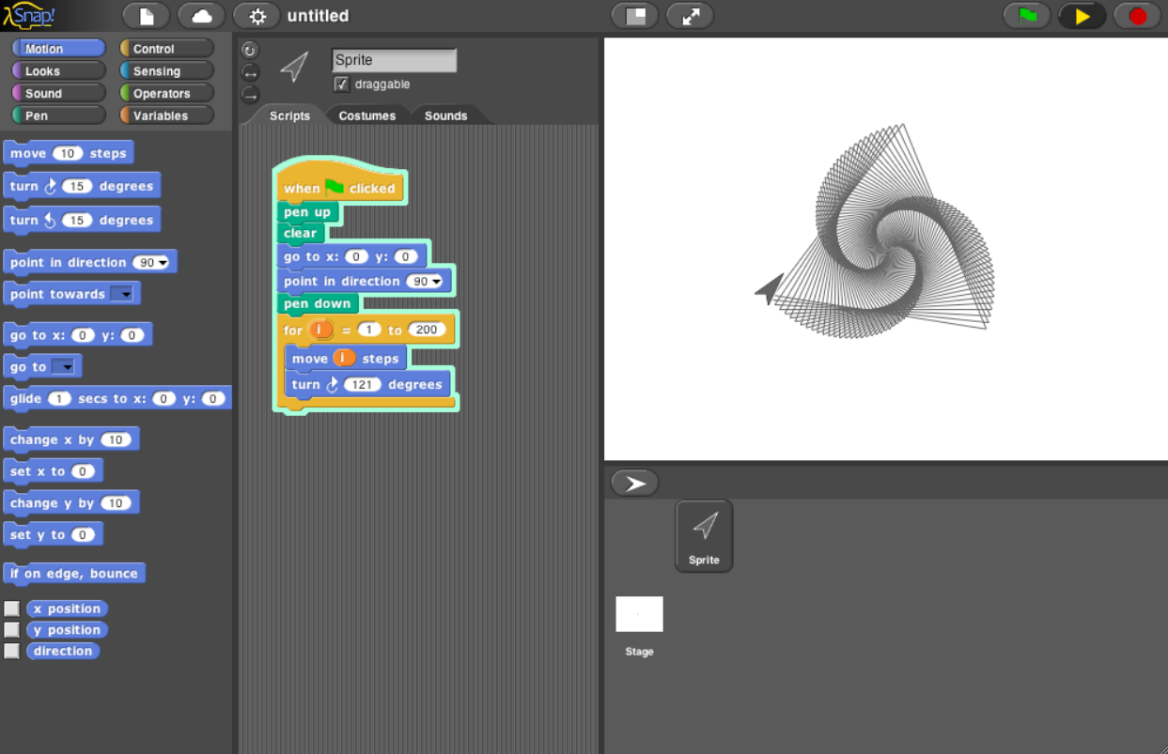
NPE Example - Snap!
Background
Novice Programming Environments
Visual, block-based language
Programmable sprites
Low floor, high ceiling
All in the browser
Integrated with BJC Curriculum (Garcia 2015)

Slide 6
Novice Programming Environments
Background
Novice Programming Environments
Examples: Scratch, Alice, Greenfoot, Snap!
Interesting: Let students create games, stories and simulations (Utting 2010)
Innovative: Features like block-based programming reduce the burden of syntax (Price 2015a)
Students use NPEs voluntarily and share knowledge (Maloney 2008)
Popular: Used in classes, clubs camps and MOOCS
Scratch is the 22nd most popular programming language (TIOBE Index, June 2016)
Notes:
Beats out Lua, Prolog and Scheme

Slide 7
Intelligent Tutoring Systems
Background
Automated Hint Generation
Designed to play the role of a human tutor (VanLehn 2006)
Guide students to better learning outcomes
E.g., support students when they get stuck
Outer Loop: problem selection (using student model)
Inner Loop: Step-by-step support on one problem
Next-step hints: answer "What do I do now?" questions

Slide 8
Data-driven Hint Generation
Background
Automated Hint Generation
Hint Factory (Barnes 2008)
Use previous students' data to model problem solving strategies
Successfully applied to many domains (e.g. logic proofs)
Overcomes challenges of expert models:
High cost of expert time (Murray 1999)
"Expert blind spot" (Alibali 2001)
Difficult to construct for large problem spaces

Slide 9
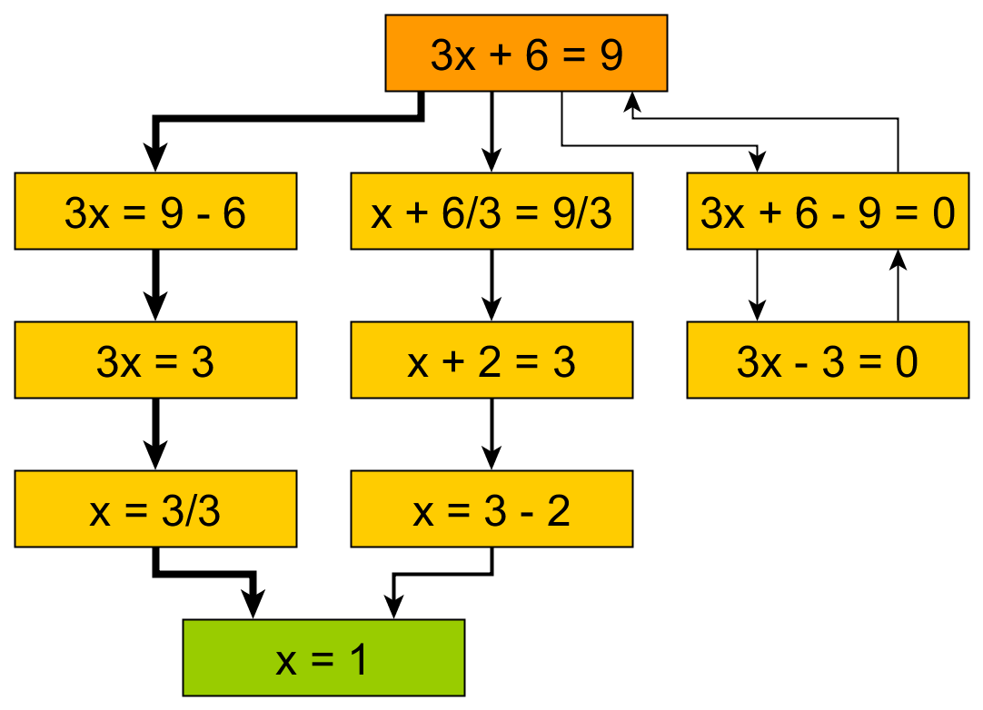
Interaction Networks
Background
Automated Hint Generation
Actions
(Edges)
Start State
States
Frequency
Solution Path
Goal State
(Eagle 2012)

Slide 10
The Hint Factory
Background
Automated Hint Generation
You are Here
Hint: Go Here
Hint: Go Here
You are Here

Slide 11
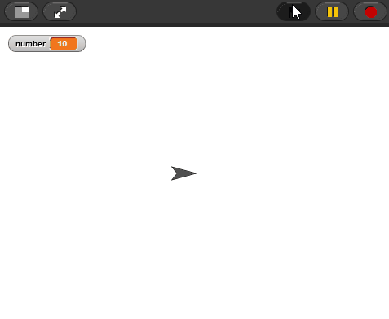
The Guessing Game
Background
Hint Generation in Programming
GuessingGame:
Say( "Welcome to the Guessing Game!" )
answer ← Ask( "What is your name?" )
Say( Join( "Hello ", answer ) )
number ← Random( 1, 10 )
doUntil ( answer == number ):
answer ← Ask( "Guess a number" )
if ( answer == number ):
Say( "Correct!" )
else:
if ( answer > number ):
Say( "Too high!" )
if ( answer < number ):
Say( "Too low!" )
Notes:
NPEs rely on open-ended programming assignments
Many variations on a correct solution
Students make meaningful design choices
Multiple, interdependent goals

Slide 12
Programming States
Background
Hint Generation in Programming
GuessingGame:
GuessingGame:
Say( "Welcome to the Guessing Game!" )
answer ← Ask( "What is your name?" )
Say( Join( "Hello ", answer ) )
number ← Random( 1, 10 )
doUntil ( answer == number ):
answer ← Ask( "Guess a number" )
if ( answer == number ):
Say( "Correct!" )
else:
if ( answer > number ):
Say( "Too high!" )
if ( answer < number ):
Say( "Too low!" )
GuessingGame:
Say( )
GuessingGame:
Say( "Welcome to the Guessing Game!" )
GuessingGame:
Say( "Welcome to the Guessing Game!" )
answer ←
GuessingGame:
Say( "Welcome to the Guessing Game!" )
answer ← Ask( "What is your name?" ))

Slide 13
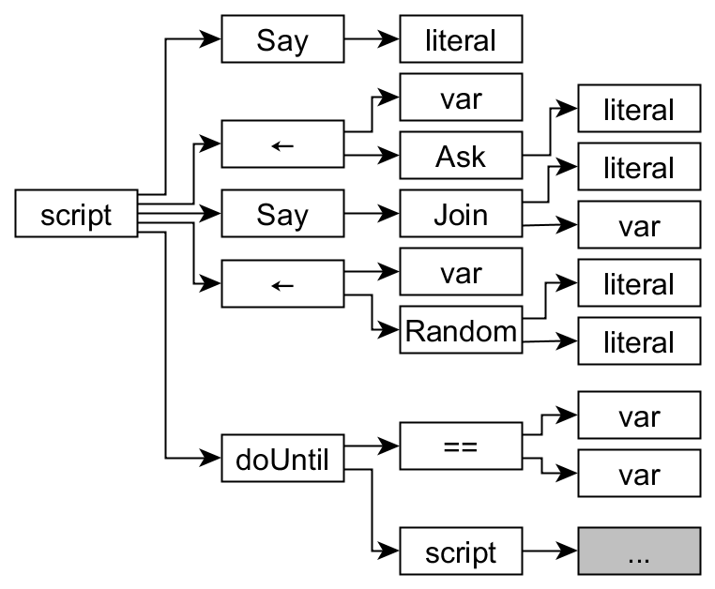
Abstract Syntax Trees
Background
Hint Generation in Programming
GuessingGame:
Say( "Welcome to the Guessing Game!" )
answer ← Ask( "What is your name?" )
Say( Join( "Hello ", answer ) )
number ← Random( 1, 10 )
doUntil ( answer == number ):
answer ← Ask( "Guess a number" )
if ( answer == number ):
Say( "Correct!" )
else:
if ( answer > number ):
Say( "Too high!" )
if ( answer < number ):
Say( "Too low!" )

Slide 14
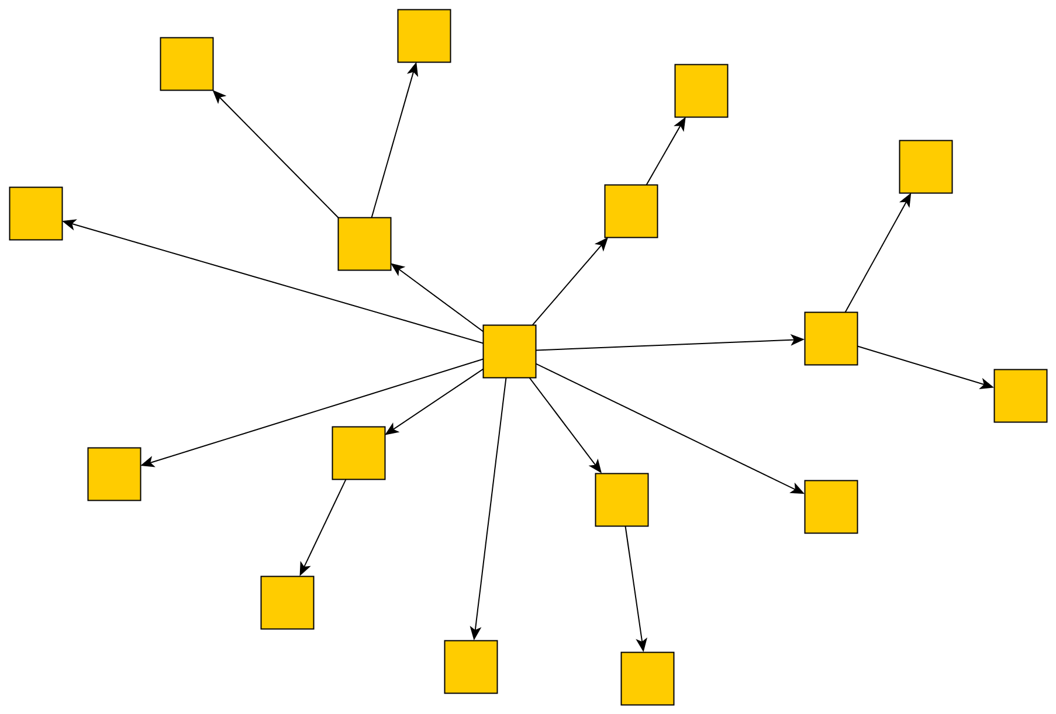
Programming States
Background
Hint Generation in Programming

Slide 15
Challenges of Using Data
Background
Hint Generation in Programming
Programming is a challenge for data-driven methods
Student solutions have very little overlap (Price 2015b)
Challenges overcome by:
Modeling the output of a program, rather than code (Hicks 2014)
Canonicalizing code so that it overlaps more (Rivers 2012)
Incorporating search to find new solutions (Rivers 2015)
Related: Automated Hint Generation
Start with a student program and search for a solution (Singh 2013)
Or transform into a similar expert solution (Zimmerman 2015)

Slide 16
Challenges of NPEs
Background
Hint Generation in Programming
NPEs rely on open-ended programming assignments
Many variations on a correct solution
Students make meaningful design choices
Multiple, interdependent goals
Can we use current hint generation methods?
Students solutions have almost no overlap
Goals are difficult to automatically assess
Notes:
Must store number before you can guess it or loop

Slide 17
Hint Generation for NPEs
The CTD Algorithm
Contextual Tree Decomposition (CTD) Algorithm
Is data driven, requiring no expert model or test cases
Can operate with minimal overlap among students

Slide 18
Root Paths
The CTD Algorithm
Terminology
GuessingGame:
Say( "Welcome to the Guessing Game!" )
answer ← Ask( "What is your name?" )
Say( Join( "Hello ", answer ) )
number ← Random( 1, 10 )
doUntil ( answer == number ):
answer ← Ask( "Guess a number" )
if ( answer == number ):
Say( "Correct!" )
else:
if ( answer > number ):
Say( "Too high!" )
if ( answer < number ):
Say( "Too low!" )
Notes:
We do this using a Root Path
This leads from the root to a node in the AST

Slide 19
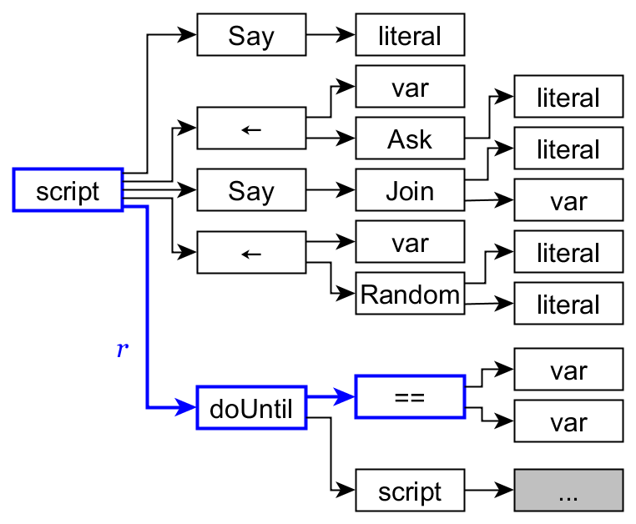
Root Paths
The CTD Algorithm
Terminology
GuessingGame:
Say( "Welcome to the Guessing Game!" )
answer ← Ask( "What is your name?" )
Say( Join( "Hello ", answer ) )
number ← Random( 1, 10 )
doUntil ( answer == number ):
answer ← Ask( "Guess a number" )
if ( answer == number ):
Say( "Correct!" )
else:
if ( answer > number ):
Say( "Too high!" )
if ( answer < number ):
Say( "Too low!" )
Notes:
Here we have the {script, doUntil, ==} RP
Notice the hierarchy
It's different than the other == RPs
RPs break the program down into pieces
There are a number of root paths
The piece of code a RP represents is the children underneath it

Slide 20
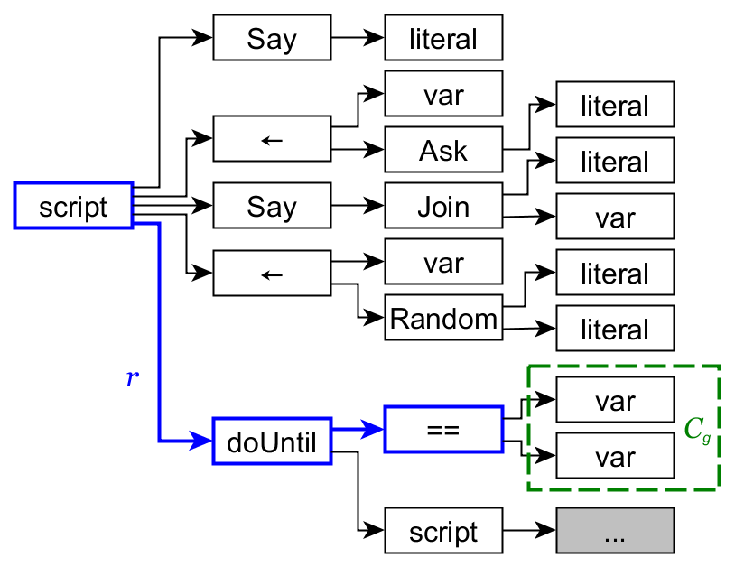
Root Paths
The CTD Algorithm
Terminology
GuessingGame:
Say( "Welcome to the Guessing Game!" )
answer ← Ask( "What is your name?" )
Say( Join( "Hello ", answer ) )
number ← Random( 1, 10 )
doUntil ( answer == number ):
answer ← Ask( "Guess a number" )
if ( answer == number ):
Say( "Correct!" )
else:
if ( answer > number ):
Say( "Too high!" )
if ( answer < number ):
Say( "Too low!" )
Notes:
We want to model how students change the children of ==
Corresponds to the things being compared
We do this using a CIN

Slide 21
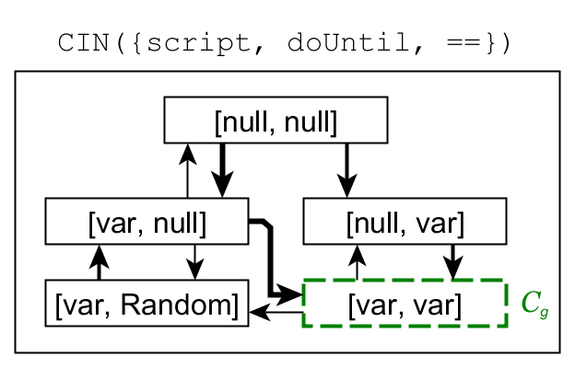
Contextual Interaction Networks (CINs)
The CTD Algorithm
Terminology
Root Path
Notes:
A CIN is a small IN that models changes to the children of a node
CIN(RP)
The current state is [var, var]
But there are other states
As a student edits the elements being compared, their state changes

Slide 22
Adding Students
The CTD Algorithm
Generating Hints
Input: a set of student solution paths from historical data
Output: a set of CINs that model student problem solving strategies

Slide 23
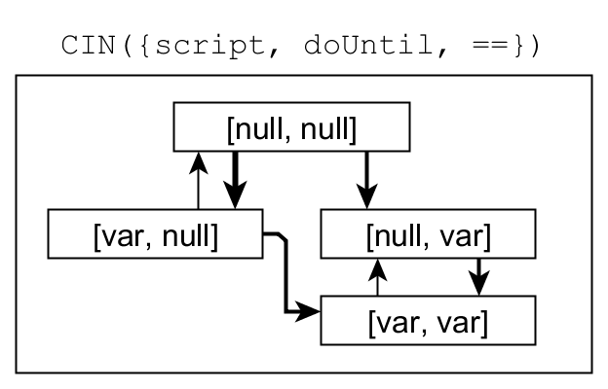
Adding Students
The CTD Algorithm
Generating Hints
GuessingGame:
Say( "Welcome to the Guessing Game!" )
answer ← Ask( "What is your name?" )
Say( Join( "Hello ", answer ) )

Slide 24
Adding Students
The CTD Algorithm
Generating Hints
GuessingGame:
Say( "Welcome to the Guessing Game!" )
answer ← Ask( "What is your name?" )
Say( Join( "Hello ", answer ) )
answer ← Ask( "Guess a number" )

Slide 25
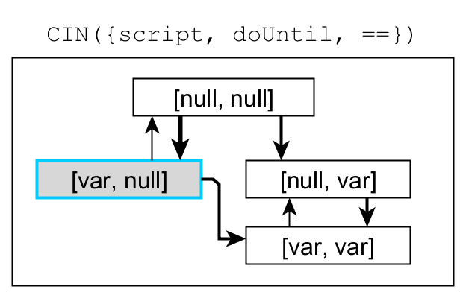
Adding Students
The CTD Algorithm
Generating Hints
GuessingGame:
Say( "Welcome to the Guessing Game!" )
answer ← Ask( "What is your name?" )
Say( Join( "Hello ", answer ) )
answer ← Ask( "Guess a number" )
doUntil ( answer == ):

Slide 26
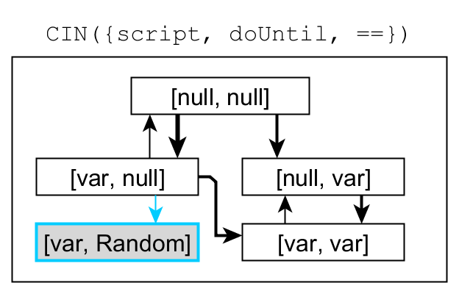
Adding Students
The CTD Algorithm
Generating Hints
GuessingGame:
Say( "Welcome to the Guessing Game!" )
answer ← Ask( "What is your name?" )
Say( Join( "Hello ", answer ) )
answer ← Ask( "Guess a number" )
doUntil ( answer == Random(1, 10) ):

Slide 27
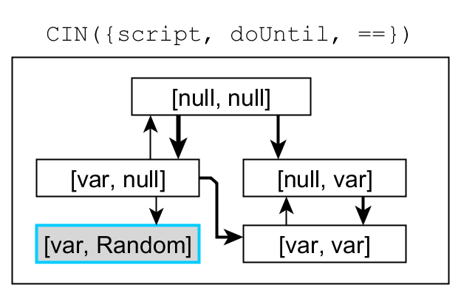
Adding Students
The CTD Algorithm
Generating Hints
GuessingGame:
Say( "Welcome to the Guessing Game!" )
answer ← Ask( "What is your name?" )
Say( Join( "Hello ", answer ) )
doUntil ( answer == Random(1, 10) ):
answer ← Ask( "Guess a number" )

Slide 28
Adding Students
The CTD Algorithm
Generating Hints
GuessingGame:
Say( "Welcome to the Guessing Game!" )
answer ← Ask( "What is your name?" )
Say( Join( "Hello ", answer ) )
number ← Random( 1, 10 )
doUntil ( answer == Random(1, 10) ):
answer ← Ask( "Guess a number" )

Slide 29
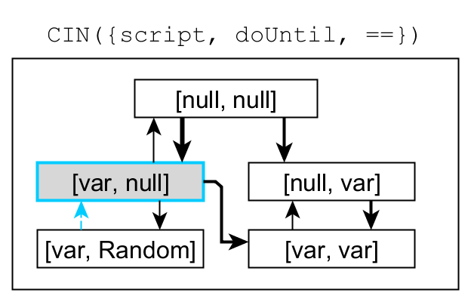
Adding Students
The CTD Algorithm
Generating Hints
GuessingGame:
Say( "Welcome to the Guessing Game!" )
answer ← Ask( "What is your name?" )
Say( Join( "Hello ", answer ) )
number ← Random( 1, 10 )
doUntil ( answer == ):
answer ← Ask( "Guess a number" )

Slide 30
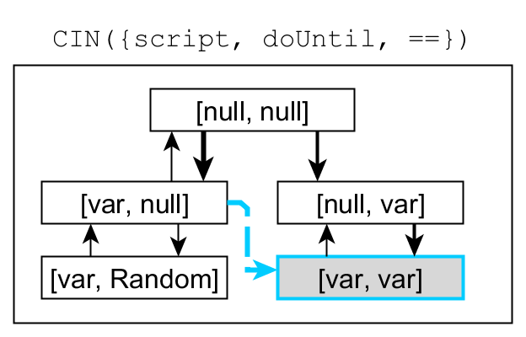
Adding Students
The CTD Algorithm
Generating Hints
GuessingGame:
Say( "Welcome to the Guessing Game!" )
answer ← Ask( "What is your name?" )
Say( Join( "Hello ", answer ) )
number ← Random( 1, 10 )
doUntil ( answer == number ):
answer ← Ask( "Guess a number" )

Slide 31
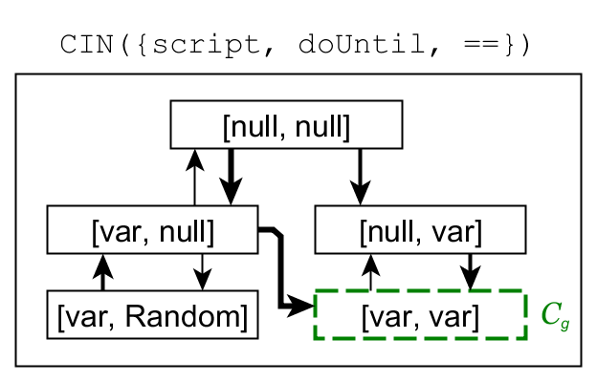
Adding Students
The CTD Algorithm
Generating Hints
GuessingGame:
Say( "Welcome to the Guessing Game!" )
answer ← Ask( "What is your name?" )
Say( Join( "Hello ", answer ) )
number ← Random( 1, 10 )
doUntil ( answer == number ):
answer ← Ask( "Guess a number" )

Slide 32
Providing Hints
The CTD Algorithm
Generating Hints
Input: the set of CINs and the student's current code
Output: a set of hints

Slide 33
Providing Hints
The CTD Algorithm
Generating Hints
GuessingGame:
number ← 8
Say( "Hi! Let's play." )
answer ← Ask( "Who's playing?" )
Say( Join( "Sup ", answer ) )
doUntil ( answer == Random( 1, 10) ):
answer ← Ask( "Guess a number" )

Slide 34
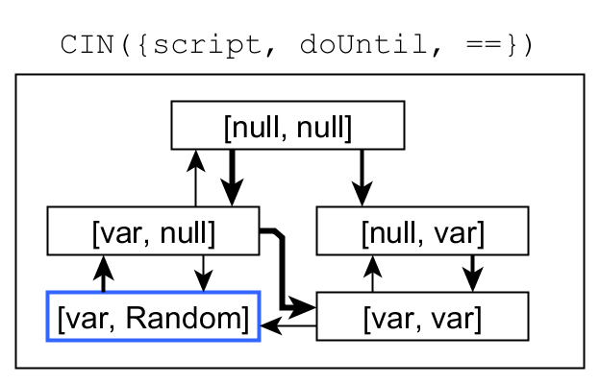
Providing Hints
The CTD Algorithm
Generating Hints
GuessingGame:
number ← 8
Say( "Hi! Let's play." )
answer ← Ask( "Who's playing?" )
Say( Join( "Sup ", answer ) )
doUntil ( answer == Random( 1, 10) ):
answer ← Ask( "Guess a number" )

Slide 35
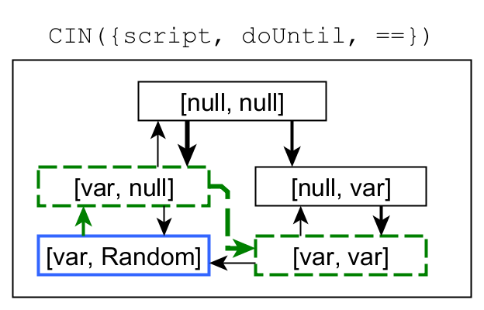
Providing Hints
The CTD Algorithm
Generating Hints
GuessingGame:
number ← 8
Say( "Hi! Let's play." )
answer ← Ask( "Who's playing?" )
Say( Join( "Sup ", answer ) )
doUntil ( answer == Random( 1, 10) ):
answer ← Ask( "Guess a number" )

Slide 36
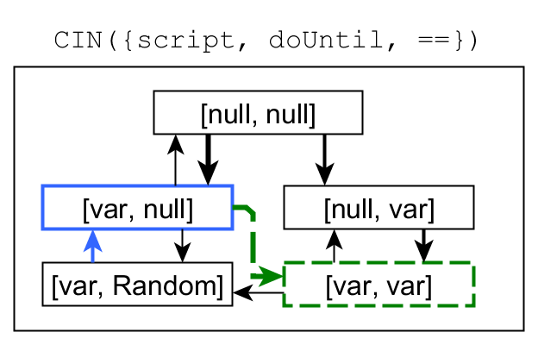
Providing Hints
The CTD Algorithm
Generating Hints
GuessingGame:
number ← 8
Say( "Hi! Let's play." )
answer ← Ask( "Who's playing?" )
Say( Join( "Sup ", answer ) )
doUntil ( answer == Random( 1, 10) ):
answer ← Ask( "Guess a number" )

Slide 37
Technical Evaluation
Technical Evaluation
Methods
Used historical data:
51 students in an intro CS course for non-majors
Logs from in-lab work on the Guessing Game assignment
9109 program snapshots - very sparse:
85% of snapshots found in only one submission
92% of submissions had a unique solution
Hint generation:
Used CTD to generate hints for each snapshot
Hints for each student were generated with the other 50 students' data

Slide 38
Hint Policies
Technical Evaluation
Methods
CTD All: CTD hints using all data (n=51).
CTD Exemplar: CTD hints using data from correct submissions (n=32).
Direct Expert*: Direct modification towards an ideal solution.
Direct Student*: Direct modification towards the student's own solution.
*Generated using (Zimmerman 2015)

Slide 39
Can CTD Provide Hints Reliably?
Technical Evaluation
Analysis
Repeatedly applied hints to 50 time-slices from each student's work
CTD hints could finish the assignment from all slices
CTD All policy solutions achieved 89.5-93.2% of objectives
Imperfect solutions all missed the same objective
CTD Exemplar achieved 98.5-100%
Number of hints needed decreased linearly with time

Slide 40
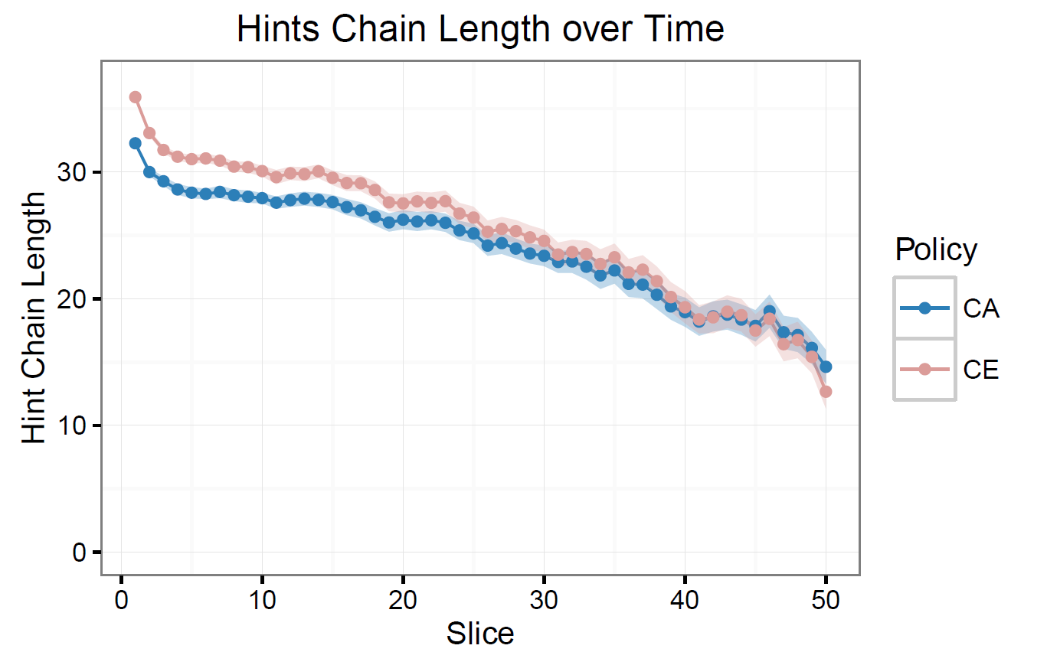
Can CTD Provide Hints Reliably?
Technical Evaluation
Analysis
CTD All
CTD Exemplar
Notes:
For context, the average submitted solution takes ~50 edits to produce directly.
Students were 10-15 edits from their final solution around 93% of the way through the assignment

Slide 41
Do CTD Hints Satisfy Objectives?
Technical Evaluation
Analysis
Do hints complete new objectives?
Generated hints for all snapshots
Identified when a hint would complete an uncompleted objective (before the student)

Slide 42
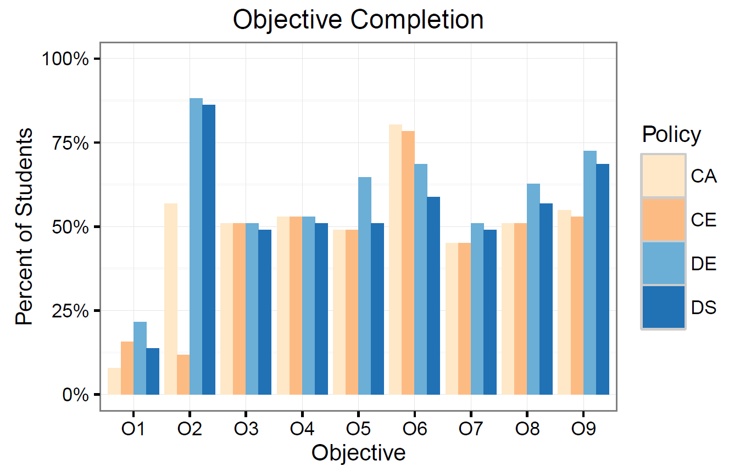
Do CTD Hints Satisfy Objectives?
Technical Evaluation
Analysis
CTD All
CTD Exemplar
Direct Expert
Direct Student

Slide 43
Do CTD Hints Satisfy Objectives?
Technical Evaluation
Analysis
Do hints complete new objectives?
Generated hints for all snapshots
Identified when a hint would complete an uncompleted objective (before the student)
Do hints undo objectives?
Generated hints for each snapshot
For each objective a student completed:
Counted if a hint "undid" the complete objective

Slide 44
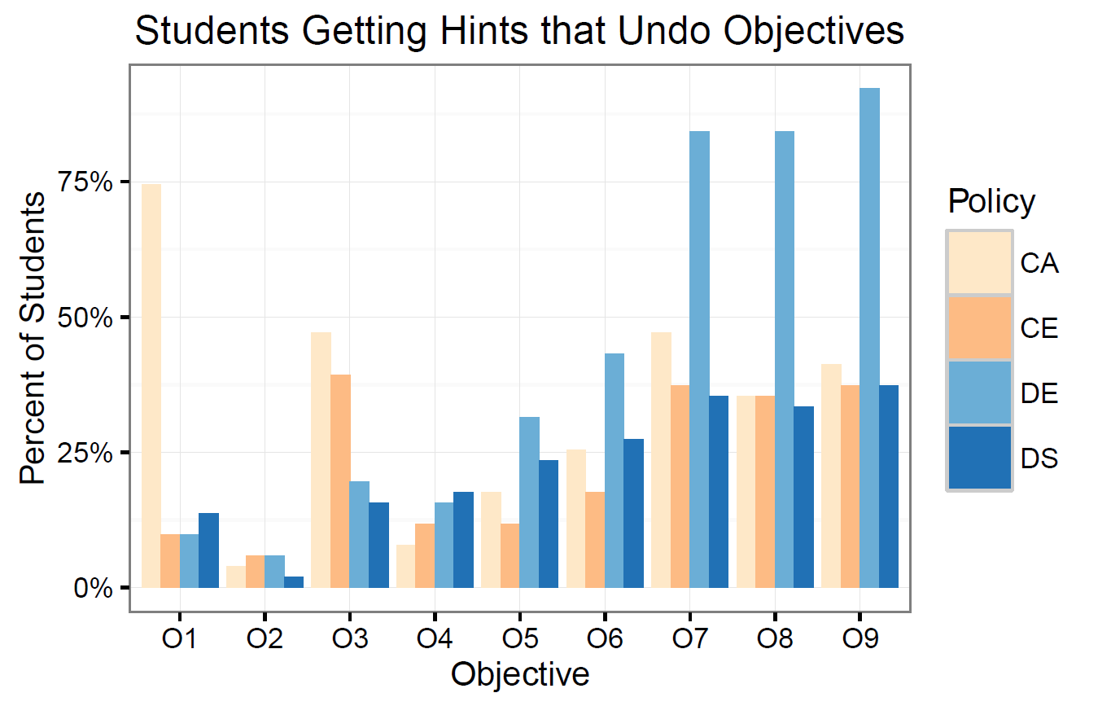
Do CTD Hints Satisfy Objectives?
Technical Evaluation
Analysis
CTD All
CTD Exemplar
Direct Expert
Direct Student

Slide 45
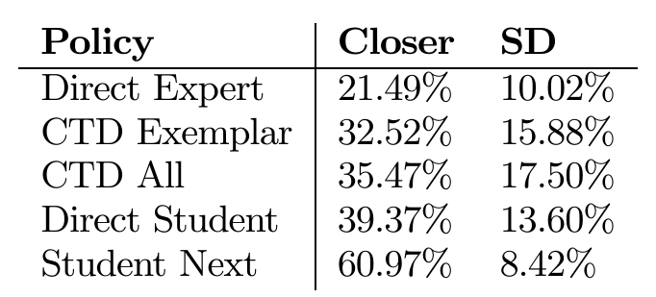
Are CTD Hints Reasonable?
Technical Evaluation
Analysis
Reasonable hints should get students closer to their submitted solution
Counted the percent of hints which got students closer
Compared with student's own actions
D.E. < C.E. < C.A. = D.S. < S.N.
(blue = significant differences)
Percent of hints that get closer for each policy.

Slide 46
Discussion
Technical Evaluation
Discussion
Are these results good?
Yes!
Hints are always available and lead to solutions
Despite 85% of snapshots and 92% of solutions being unique
They identify objectives most of the time without undoing them
They're as good as the Direct Student policy at pointing a student toward their final solution
But... there is still much work to do

Slide 47
Demo!
http://go.ncsu.edu/isnap

Slide 48
Thank You!
Questions?
Thomas Price (twprice@ncsu.edu)
http://go.ncsu.edu/isnap

Slide 49
References
Barnes, T., & Stamper, J. (2008). Toward Automatic Hint Generation for Logic Proof Tutoring Using Historical Student Data. In Proceedings of the 9th International Conference on Intelligent Tutoring Systems (pp. 373–382).
Corbett, A., & Anderson, J. (2001). Locus of Feedback Control in Computer-Based Tutoring: Impact on Learning Rate, Achievement and Attitudes. In Proceedings of the SIGCHI Conference on Human Computer Interaction (pp. 245–252).
Dann, W., Cosgrove, D., & Slater, D. (2012). Mediated Transfer: Alice 3 to Java. In Proceedings of the 43rd ACM Technical Symposium on Computer Science Education (pp. 141–146).
Hicks, A., Peddycord III, B., & Barnes, T. (2014). Building Games to Learn from Their Players: Generating Hints in a Serious Game. In Proceedings of the 12th International Conference on Intelligent Tutoring Systems (pp. 312–317).
Moskal, B., Lurie, D., & Cooper, S. (2004). Evaluating the Effectiveness of a New Instructional Approach. ACM SIGCSE Bulletin, 36(1), 75–79.
Price, T. W., & Barnes, T. (2015a). Comparing Textual and Block Interfaces in a Novice Programming Environment. In Proceedings of the 11th International Computing Education Research Conference.
Price, T. W., & Barnes, T. (2015b). An Exploration of Data-Driven Hint Generation in an Open-Ended Programming Problem. In Proceedings of the Workshop on Graph-Based Data Mining held at EDM’15.
Rivers, K., & Koedinger, K. (2013). Automatic Generation of Programming Feedback: A Data-driven Approach. In Proceedings of the First Workshop on AI-supported Education for Computer Science (pp. 50–59).

Slide 50
References, Cont.
Rivers, K., & Koedinger, K. R. (2015). Data-Driven Hint Generation in Vast Solution Spaces: a Self-Improving Python Programming Tutor. International Journal of Artificial Intelligence in Education, 16(1).
Singh, R., Gulwani, S., & Solar-Lezama, A. (2013). Automated Feedback Generation for Introductory Programming Assignments. ACM SIGPLAN Notices, 48(6).
Utting, I., Cooper, S., & Kölling, M. (2010). Alice, Greenfoot, and Scratch -- A Discussion. ACM Transactions on Computing Education, 10(4).
Vanlehn, K. (2006). The Behavior of Tutoring Systems. International Journal of Artifical Intelligence in Education, 16(3), 227–265.
Zimmerman, K., & Rupakheti, C. R. (2015). An Automated Framework for Recommending Program Elements to Novices. In Proceedings of the 30th International Conference on Automated Software Engineering.

Slide 51
(Backup Slides… Shhh)

Slide 52
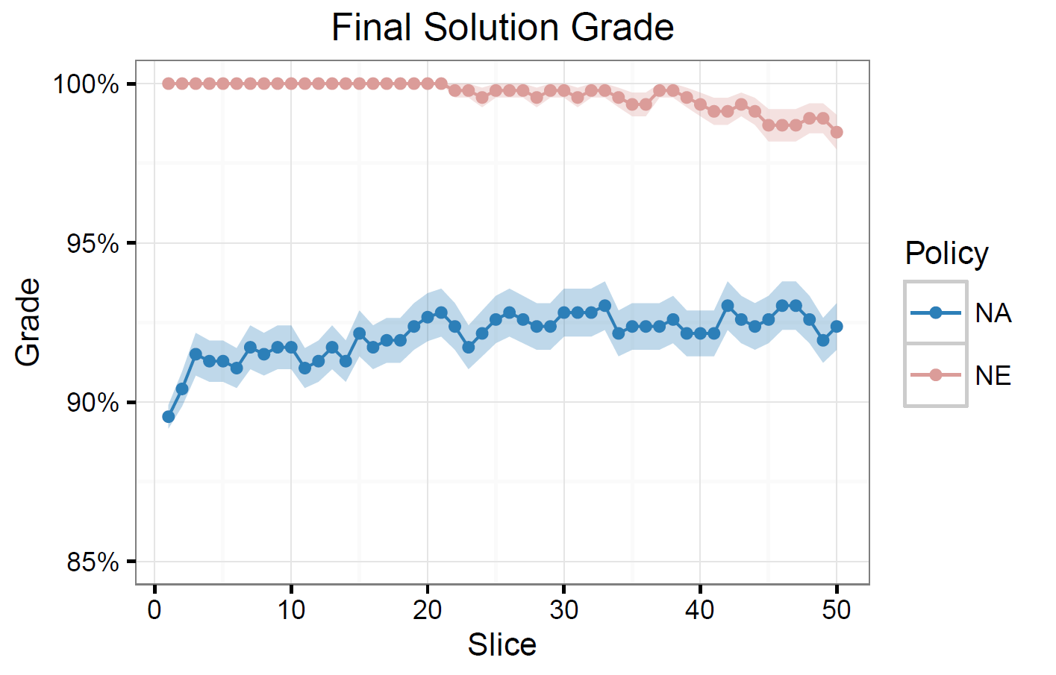
Hint-Chain Grades Over Time

Slide 53
Does Help Help? Yes!
Related Work
Hints and Feedback in ITSs
Students with hints:
Complete more of the tutor, have less dropout and have higher final course grades (Stamper 2013)
Perform better in the tutor and on assessments without hints available (Corbett 2001a)
Data analysis of hint use (Beck 2008) suggests it:
Greatly increases the likelihood of getting a problem correct
Somewhat increases the likelihood of learning content

Slide 54
Expert-model-based Tutors
Example: The ACT Programming Tutor (APT) (Anderson 1989)
Defines an expert model using if-then production rules
e.g. If goal is X, then code Y and set Z as the new goal
Uses model tracing to ensure students stay on an expert path
When the student deviates, or asks for help, offers a hint
Example: SQL-Tutor (Mitrovic 1999)
Defines an expert model using sets of constraints
e.g. When code has N left-parentheses, it must have N right parentheses
When students submit work, finds violated constraints and gives corresponding feedback

